Slide 1


Exposure CS 2022
for CS1
Chapter 17 Slides
Sequential Text Files
PowerPoint Presentation
created by:
Mr. John L. M. Schram
and Mr. Leon Schram
Authors of Exposure
Computer Science

Slide 2
Section 17.1
Introduction

Slide 3
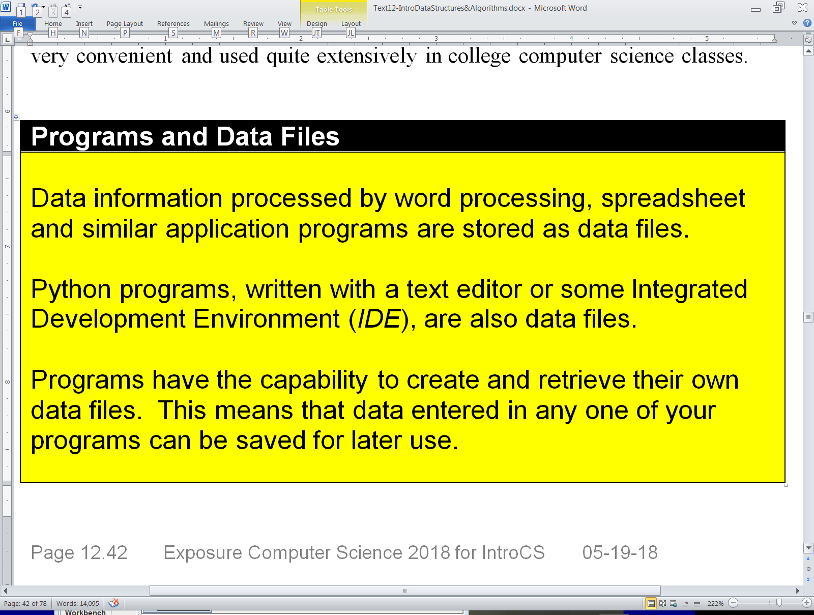
Programs and Data Files

Slide 4
Data Organization
bit | This is the fundamental building block of all computer information – a binary digit – which stores only a 1 or 0.
byte | One byte equals 8 bits. The ASCII format uses 1 byte to store a character. UTF-8 uses between 1 and 4 bytes to store a character.
field | A field is one specific unit of information. Examples: name, address, gpa, salary, diagnosis
record | A record consists of a set of fields for a specific purpose. Examples of the fields contained by different records: student record: name, address, gpa, classRank employee record: name, address, salary, position patient record: name, address, diagnosis, allergies
file | A data base file consists of a sequence of records. Example: A school can have a file of student records.

Slide 5
Section 17.2
Different Types
of Files

Slide 6
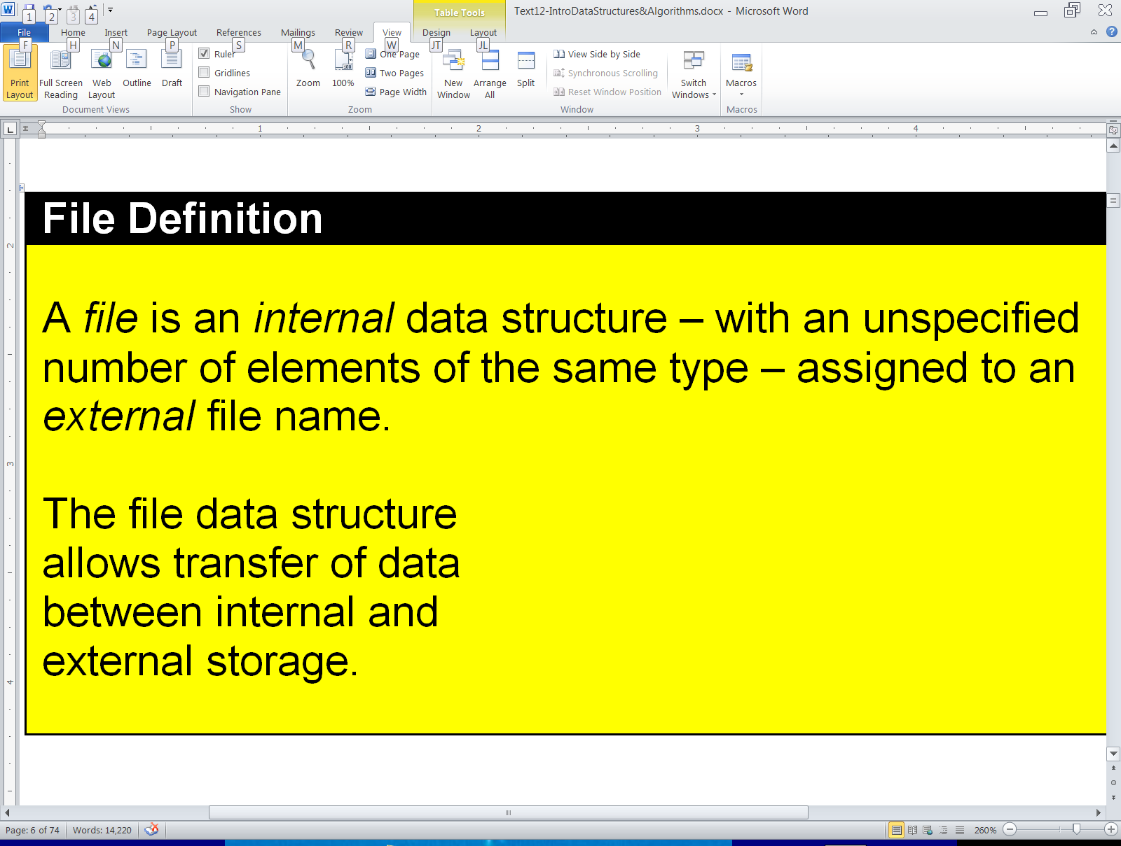

File Data Structure Definition Review

Slide 7
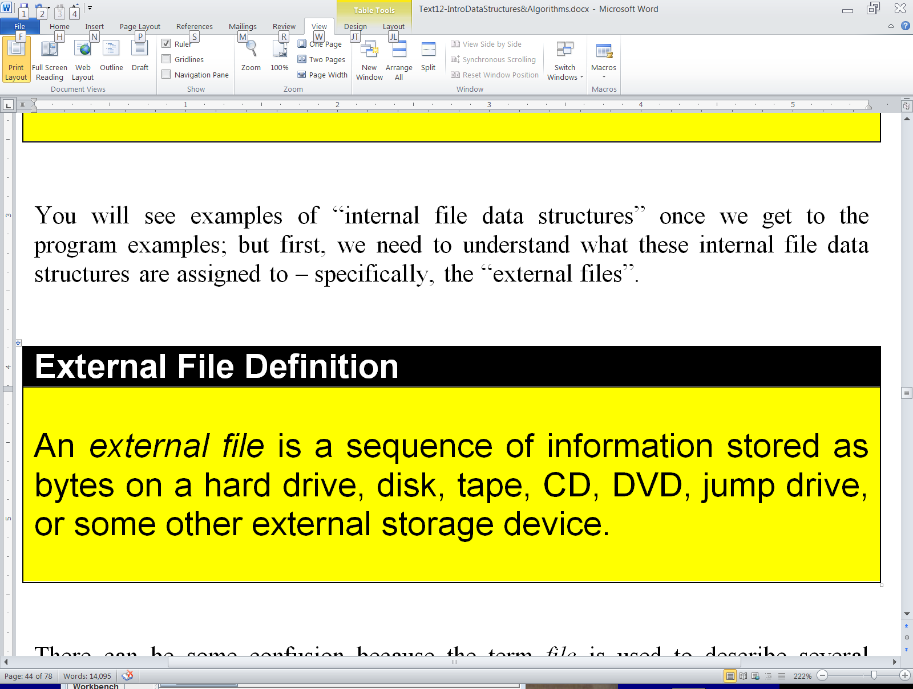


External File Definition

Slide 8
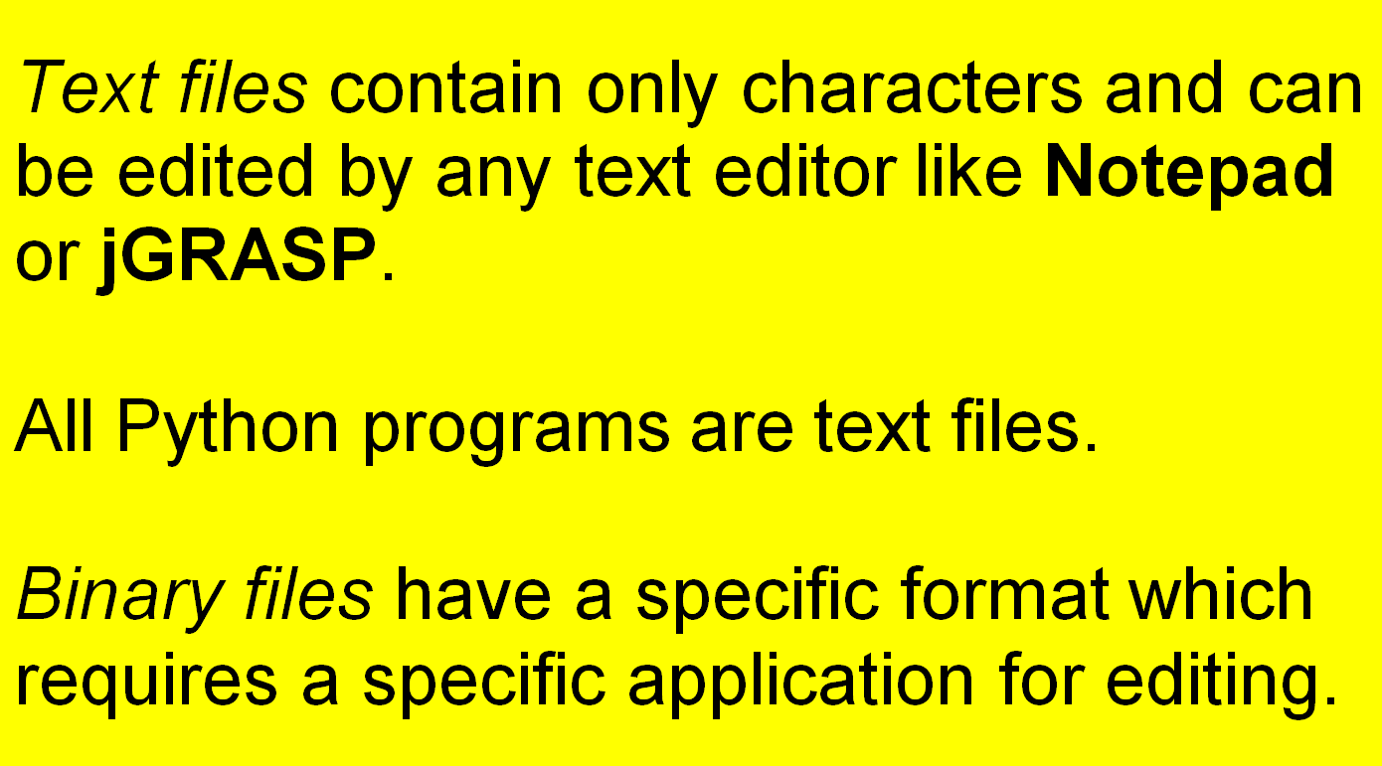
Text Files and Binary Files

Slide 9
2 Ways to Classify Files
by what they store (text vs. binary)
by how the information is accessed
(sequential access vs. random access)

Slide 10
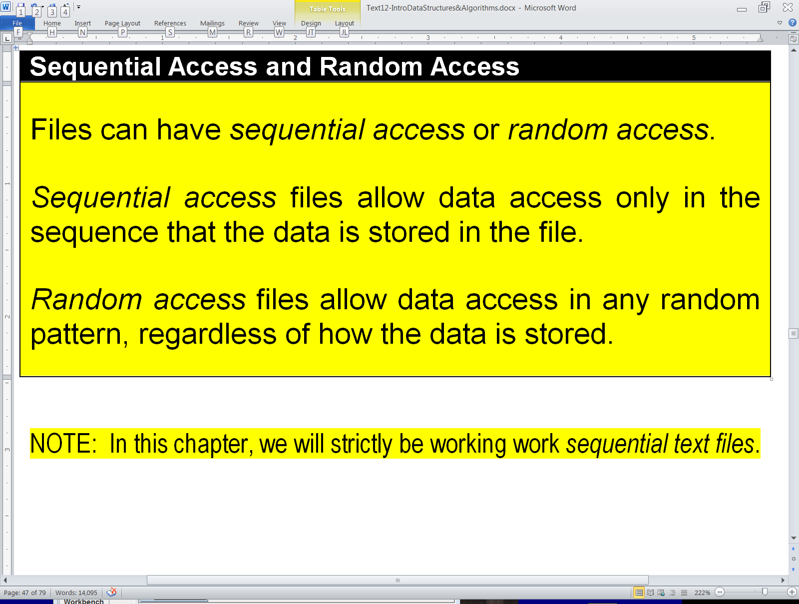
Sequential Access and Random Access

Slide 11
Sequential Access Examples

Slide 12

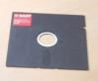
Random Access Examples

Slide 13

NOTE:
In this chapter,
we will strictly be working with
Sequential Text Files.

Slide 14
Section 17.3
Writing To and
Reading From
Text Files

Slide 15
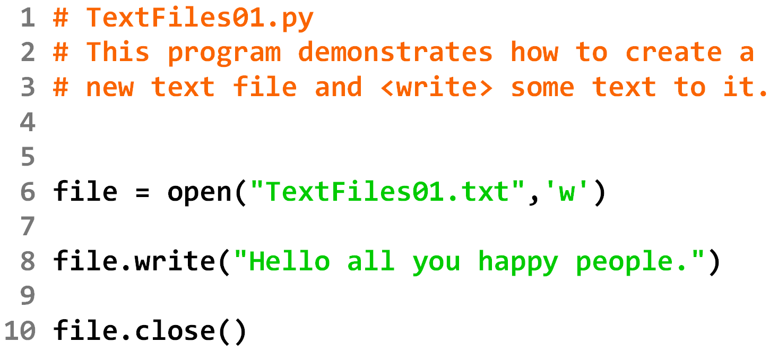

Slide 16
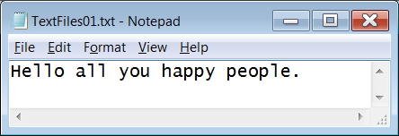

Slide 17


Slide 18
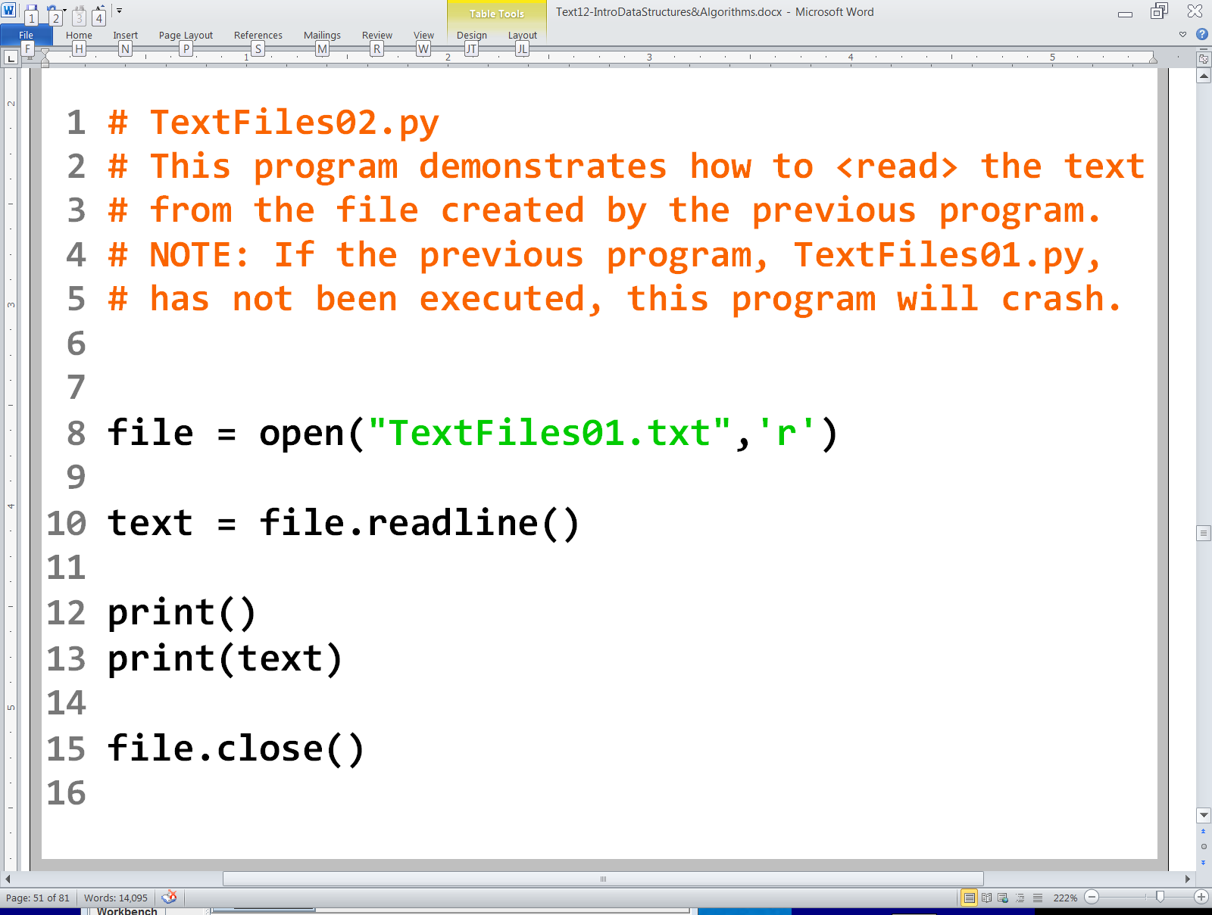

Slide 19
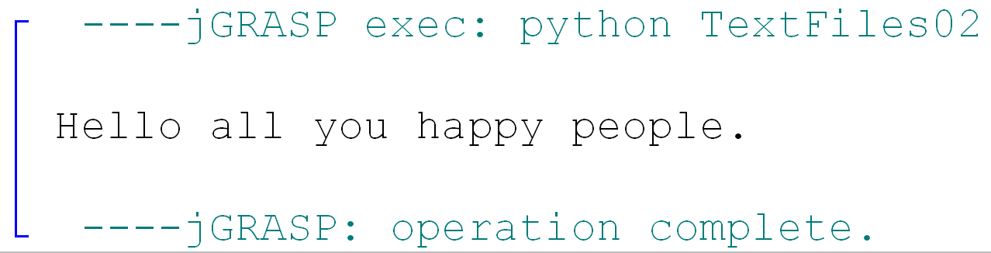

Slide 20
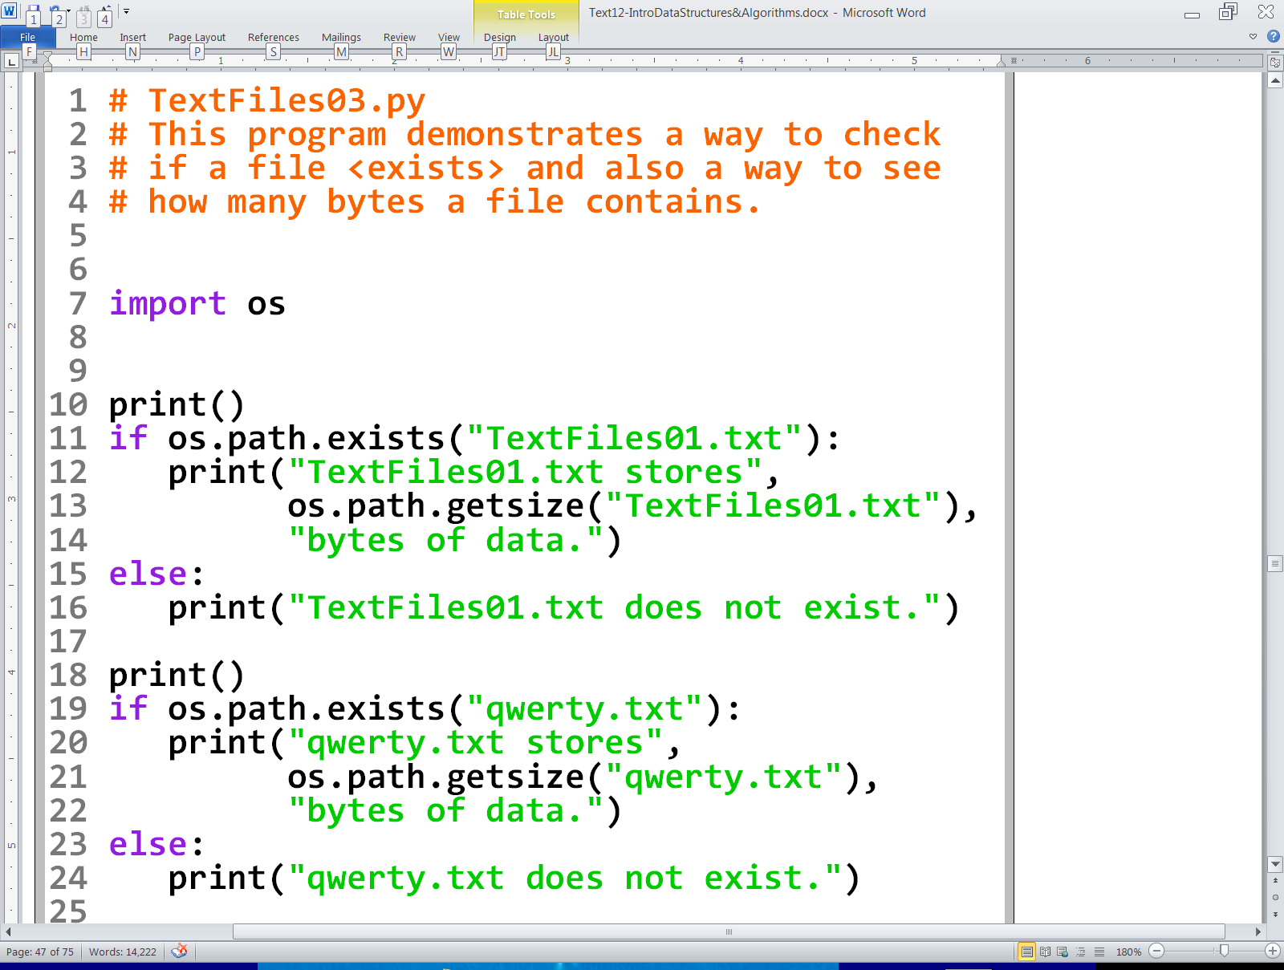

Slide 21
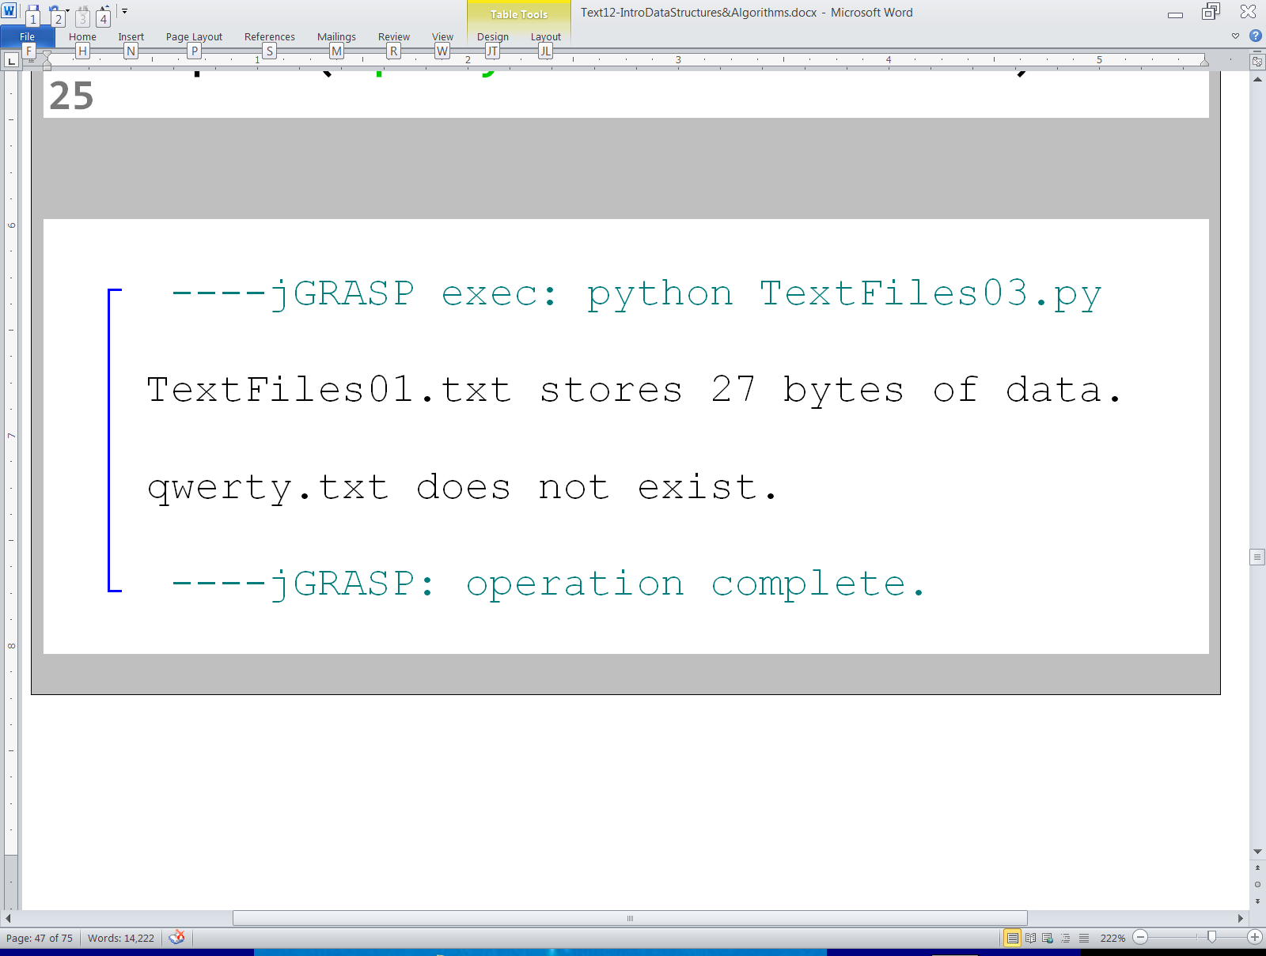

Slide 22
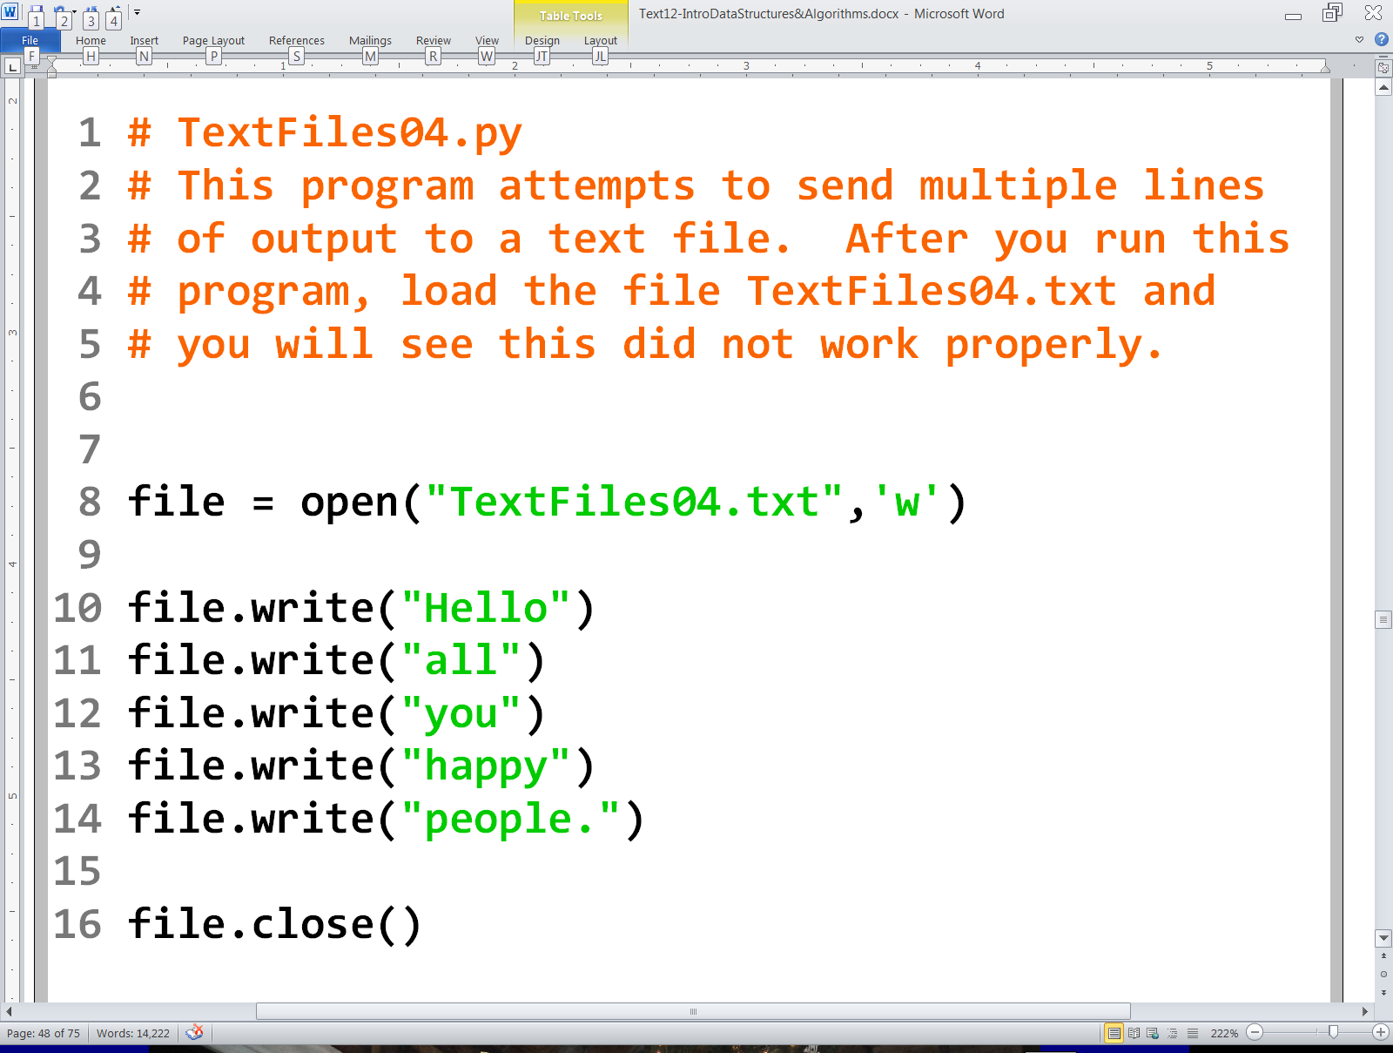

Slide 23
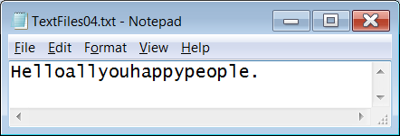

Slide 24
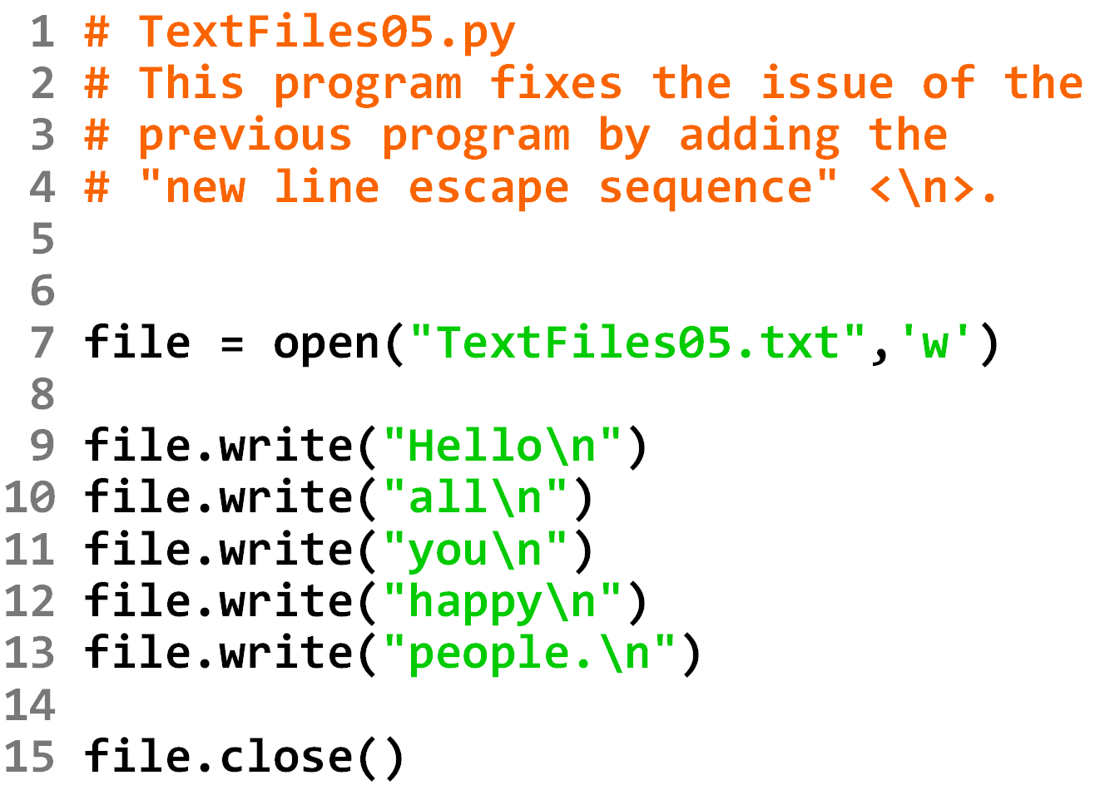

Slide 25
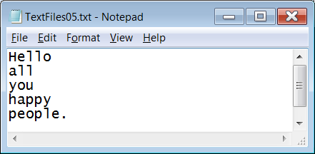

Slide 26
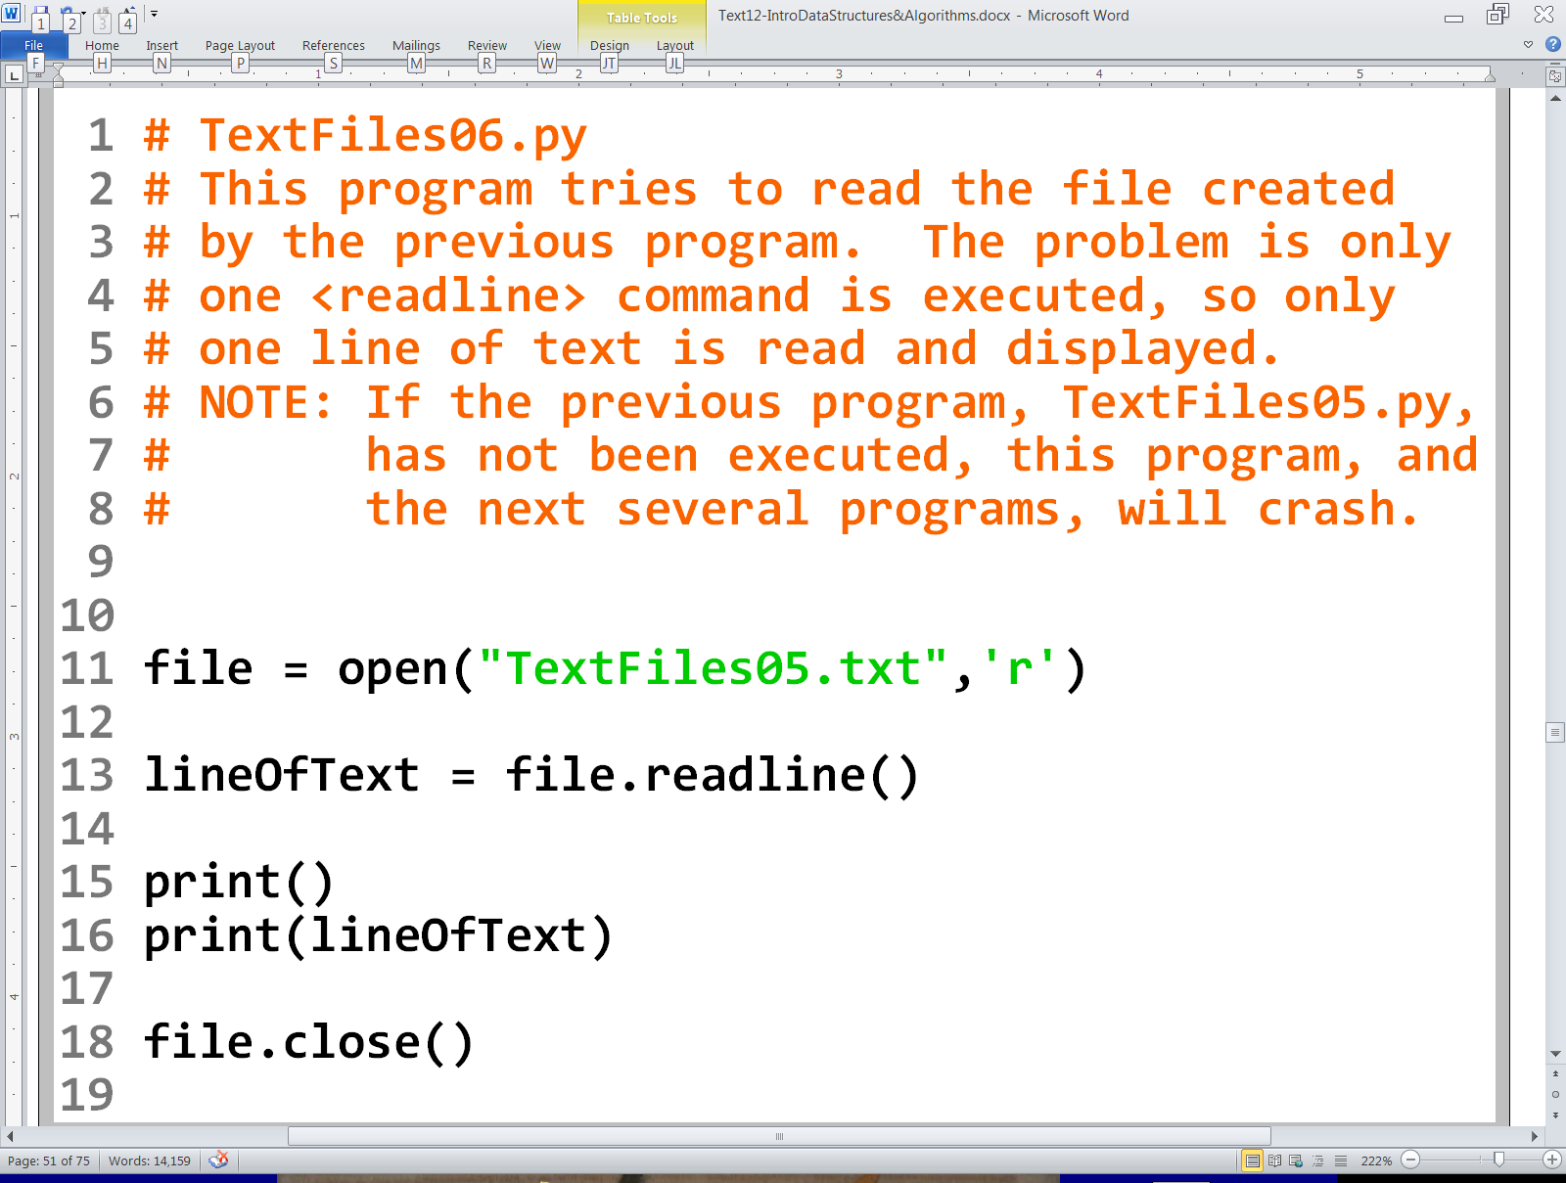

Slide 27
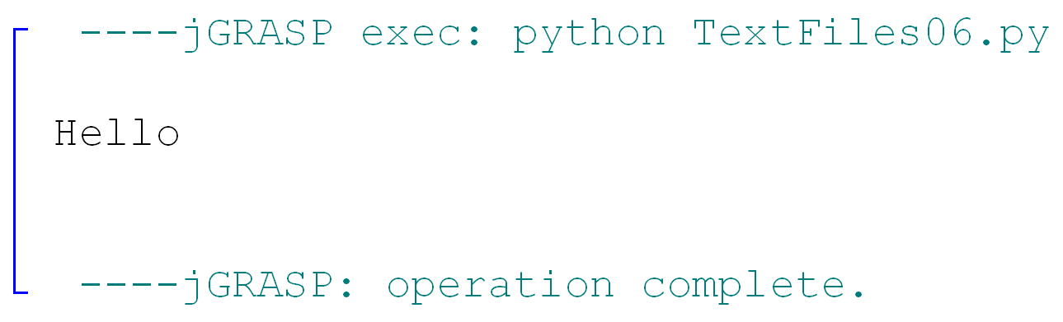

Slide 28
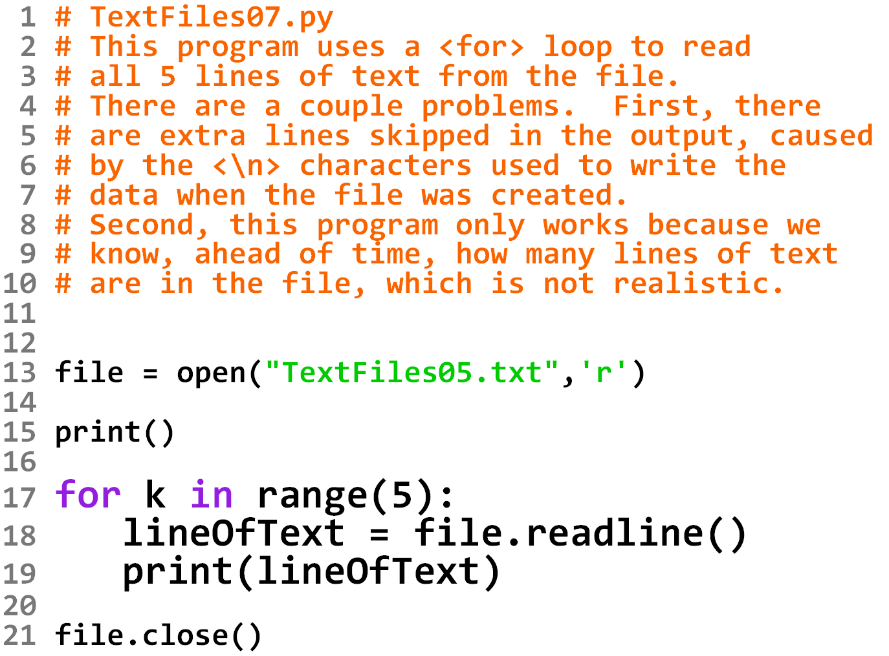

Slide 30
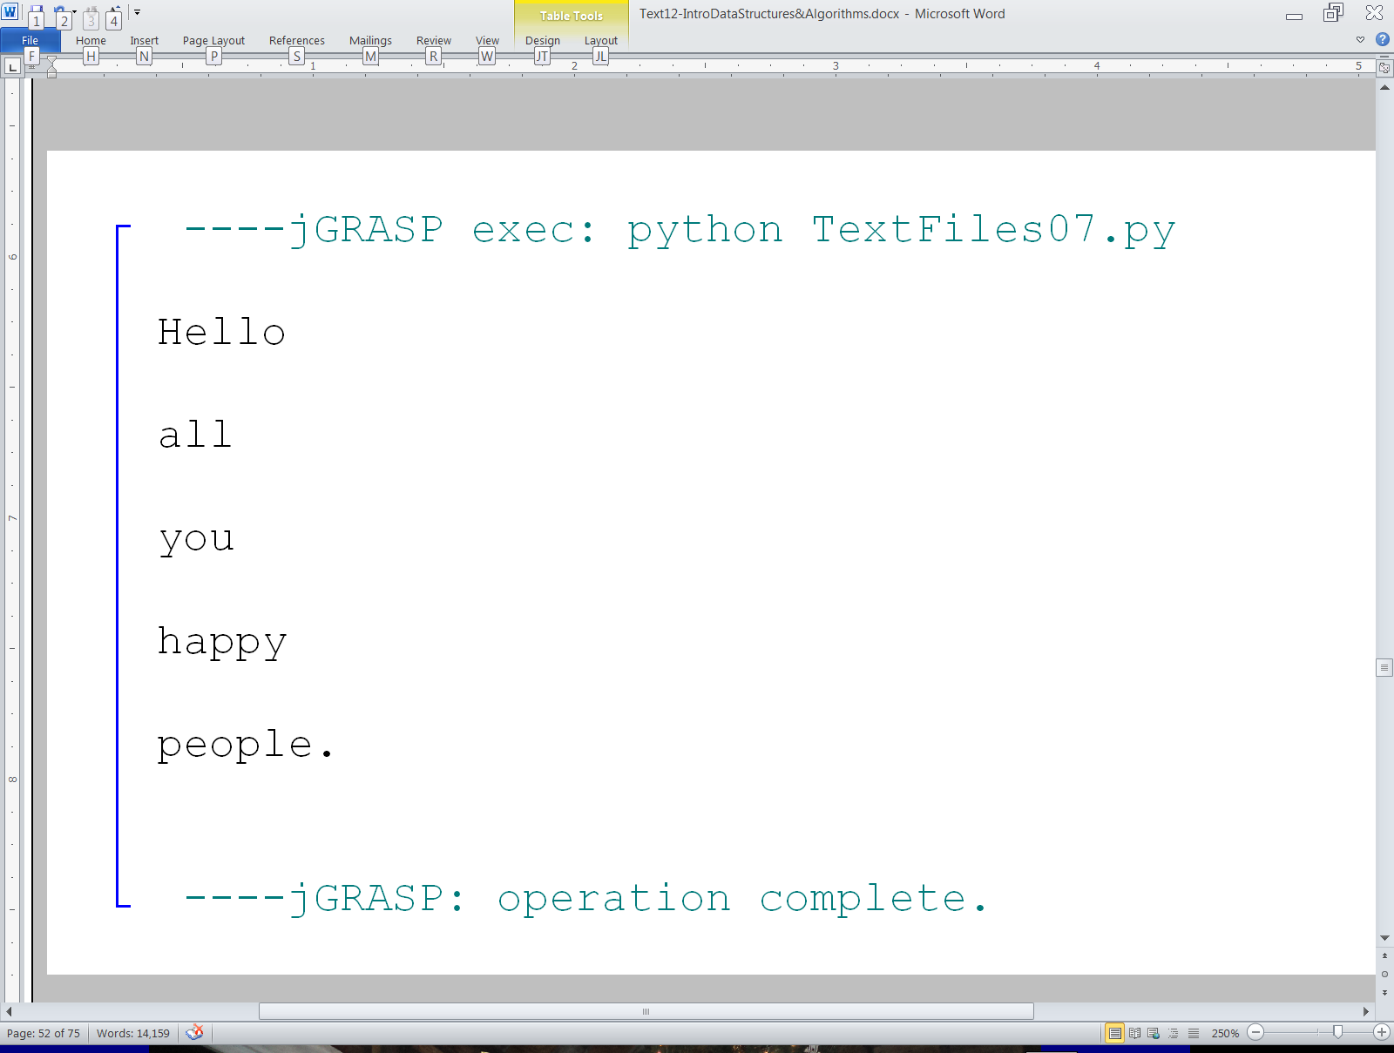

Slide 31
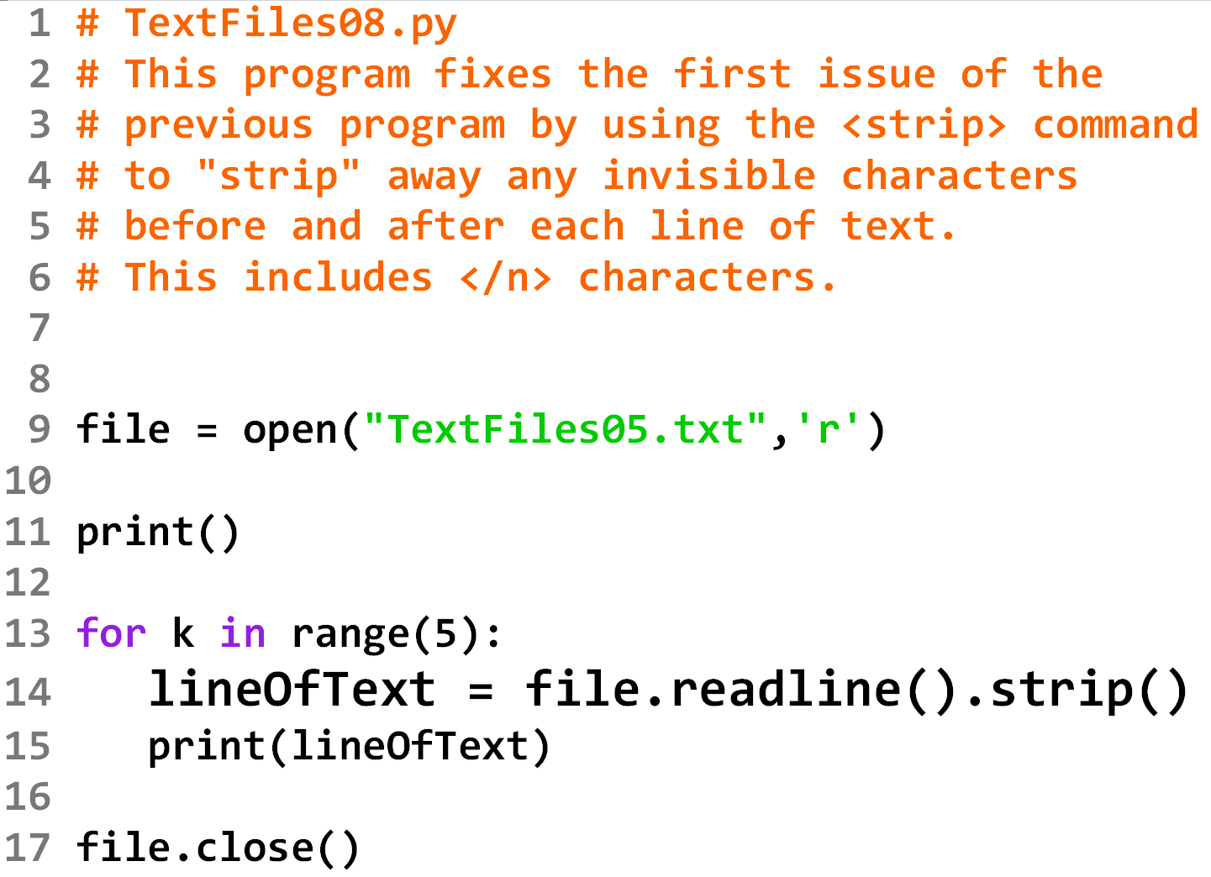

Slide 32
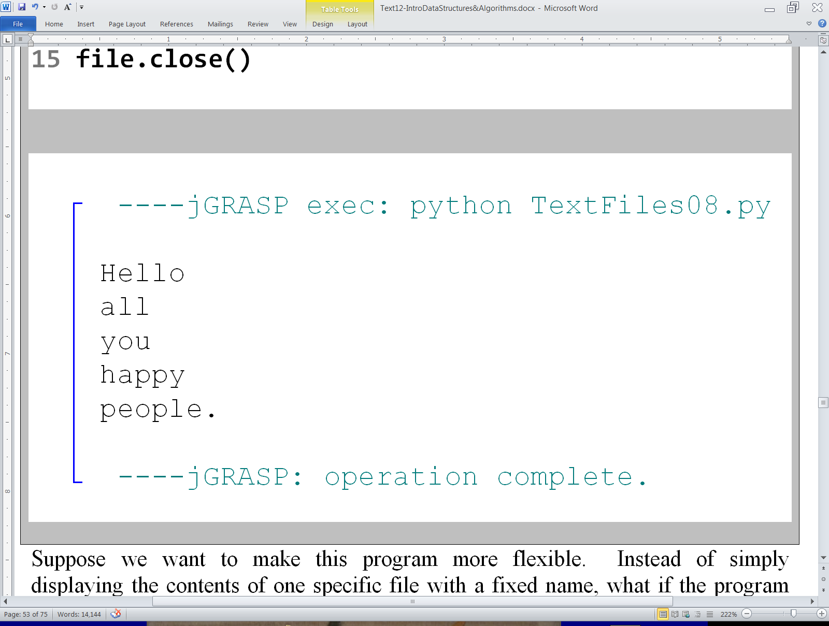

Slide 33
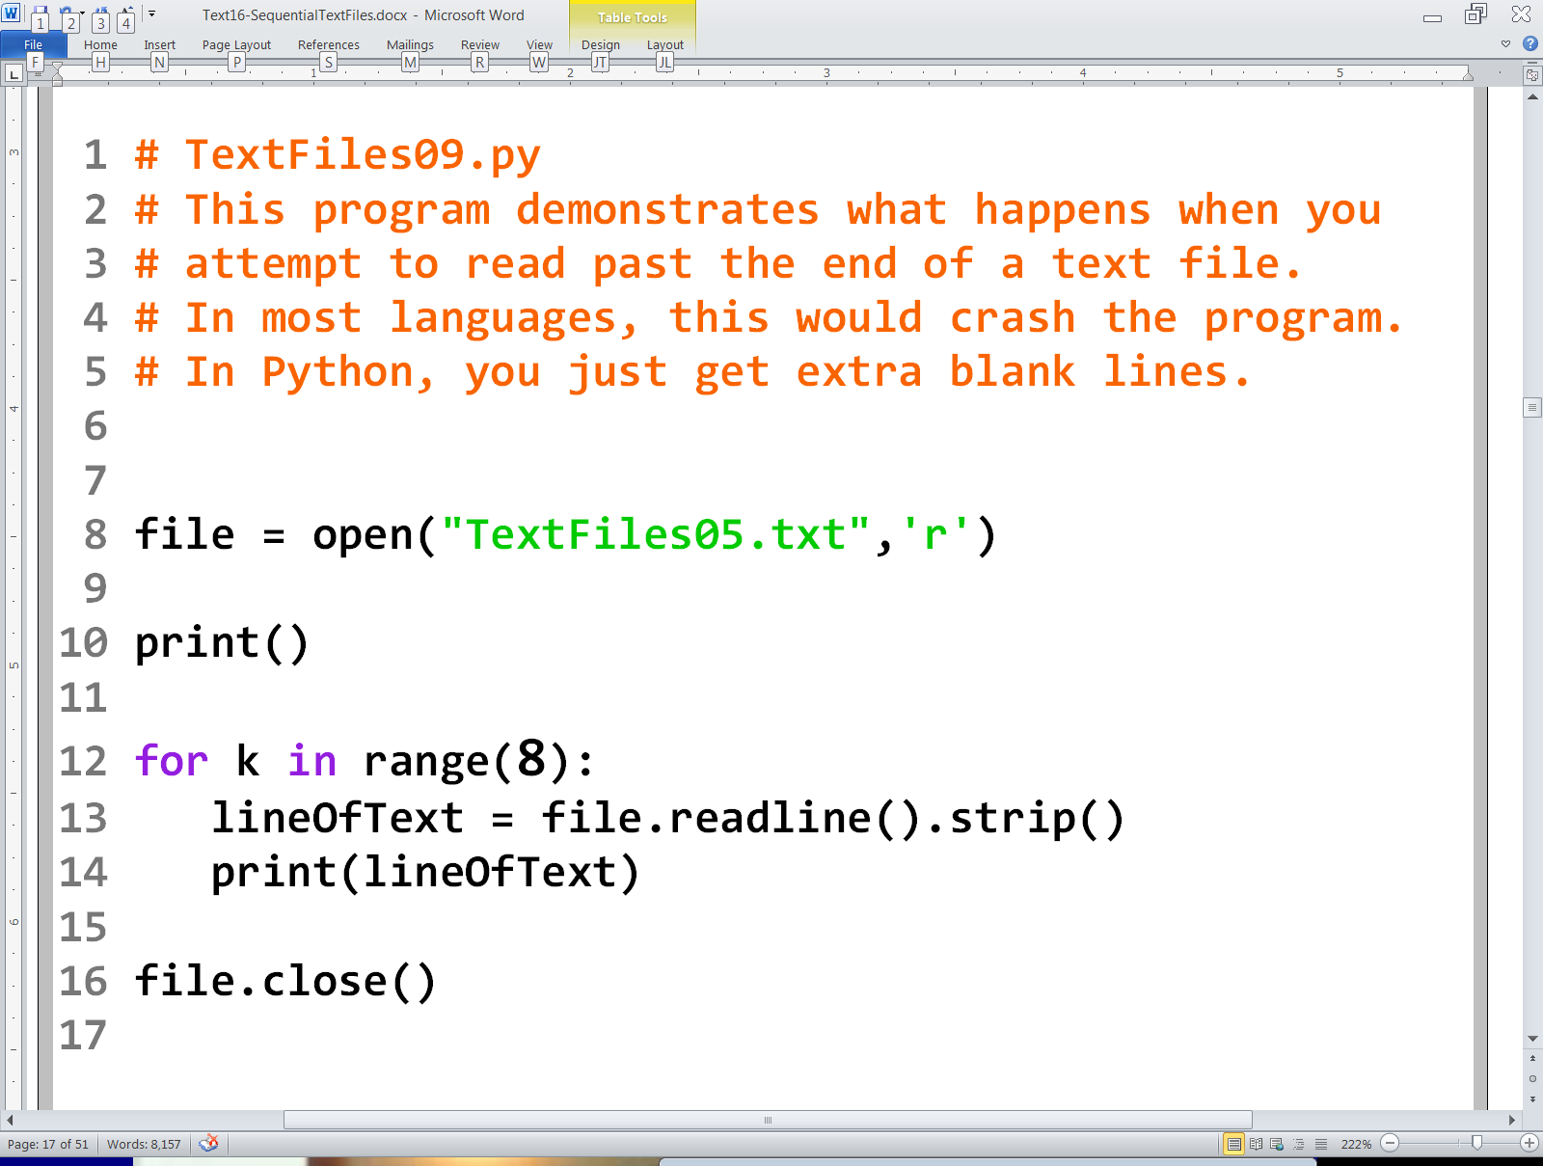

Slide 34
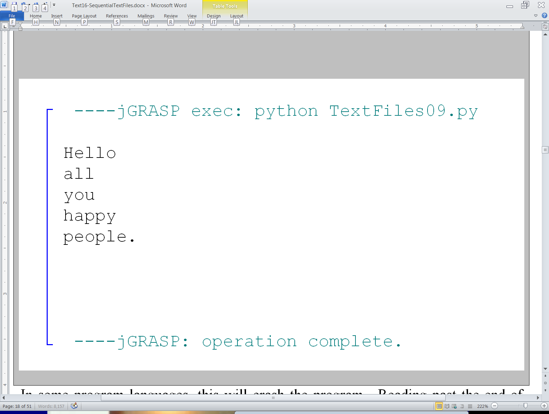

Slide 35
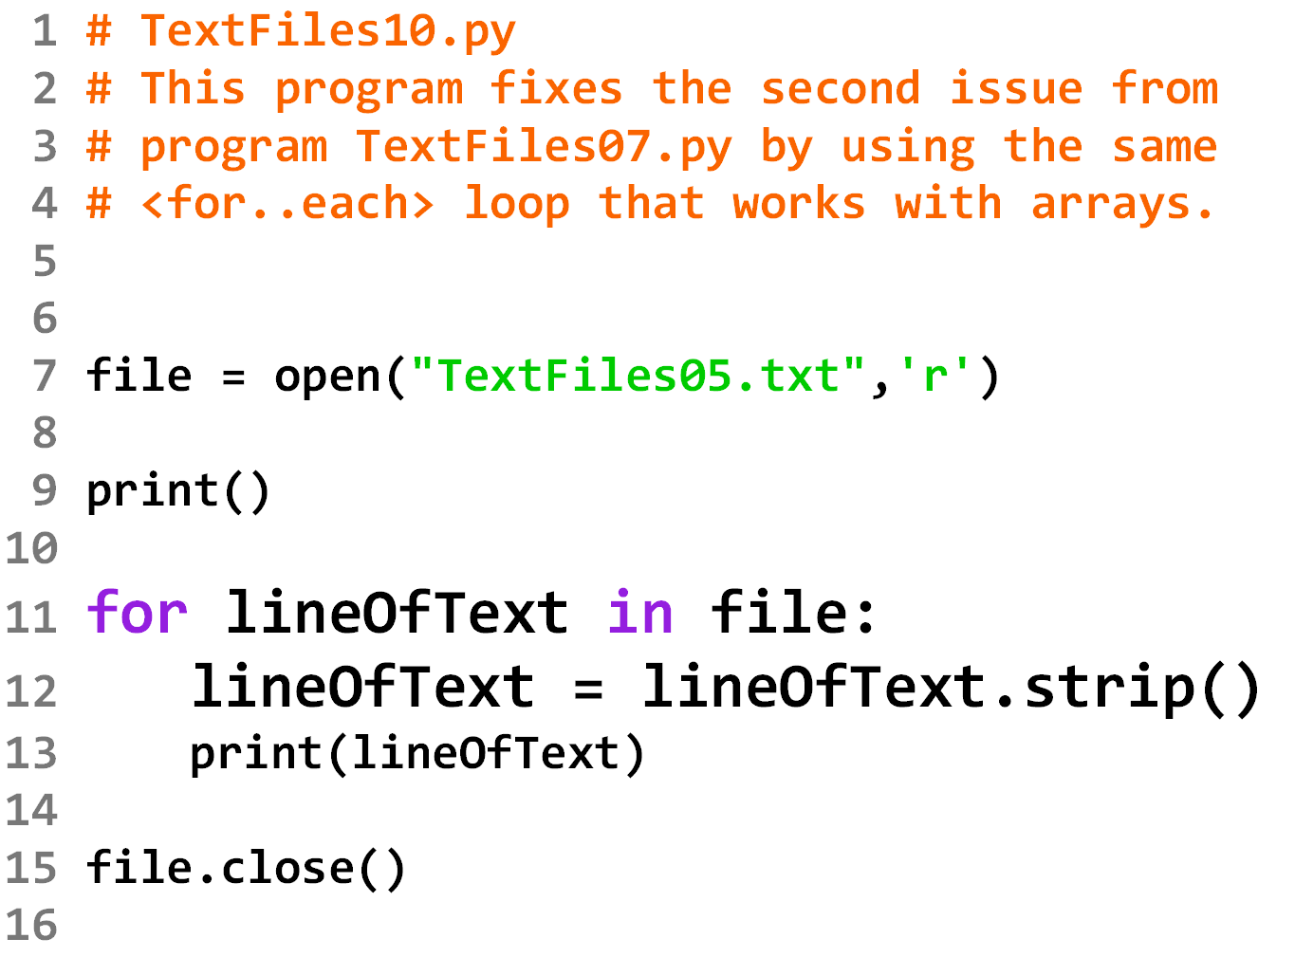

Slide 37
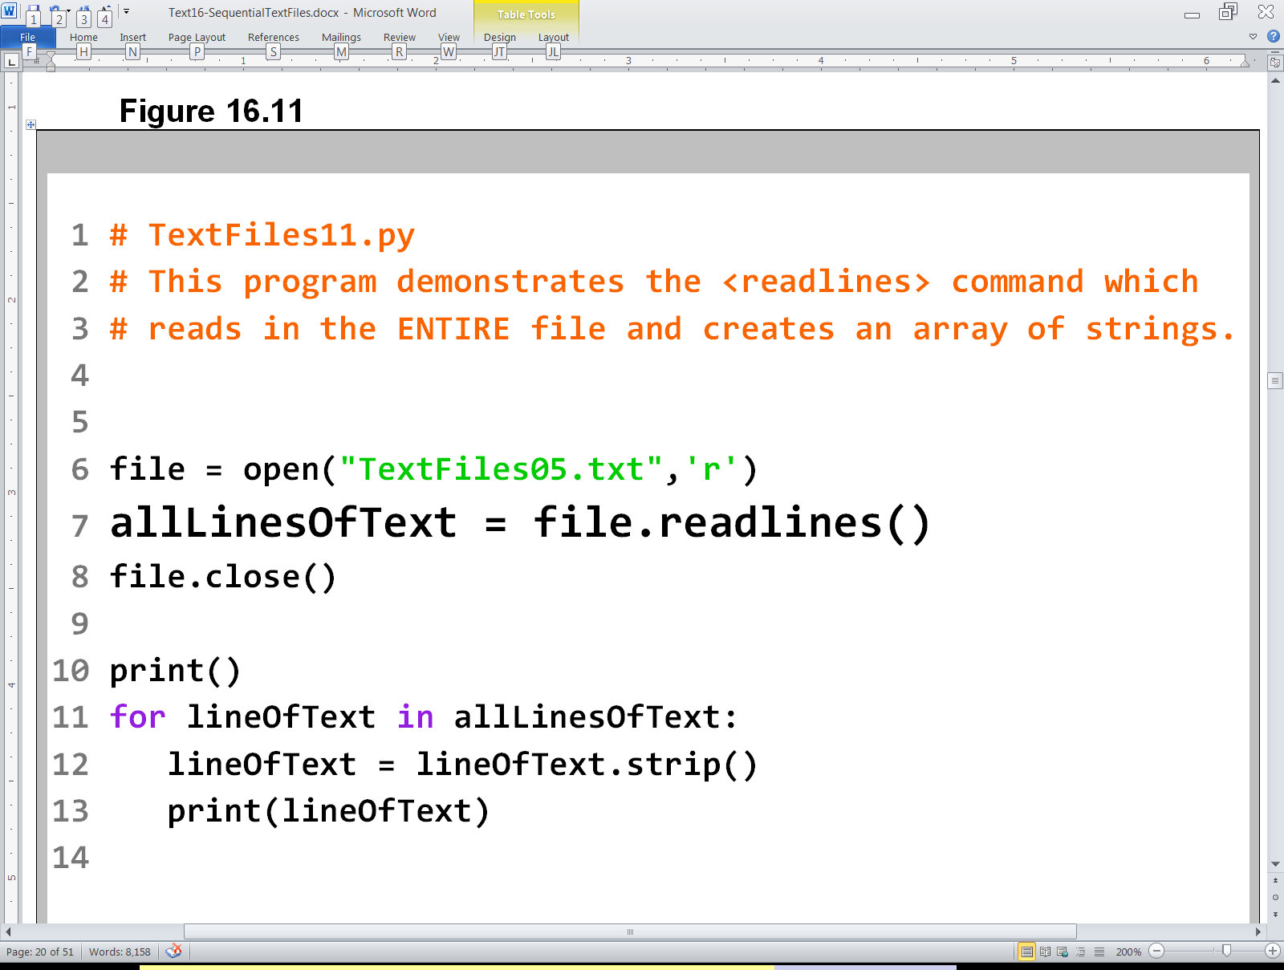

Slide 39
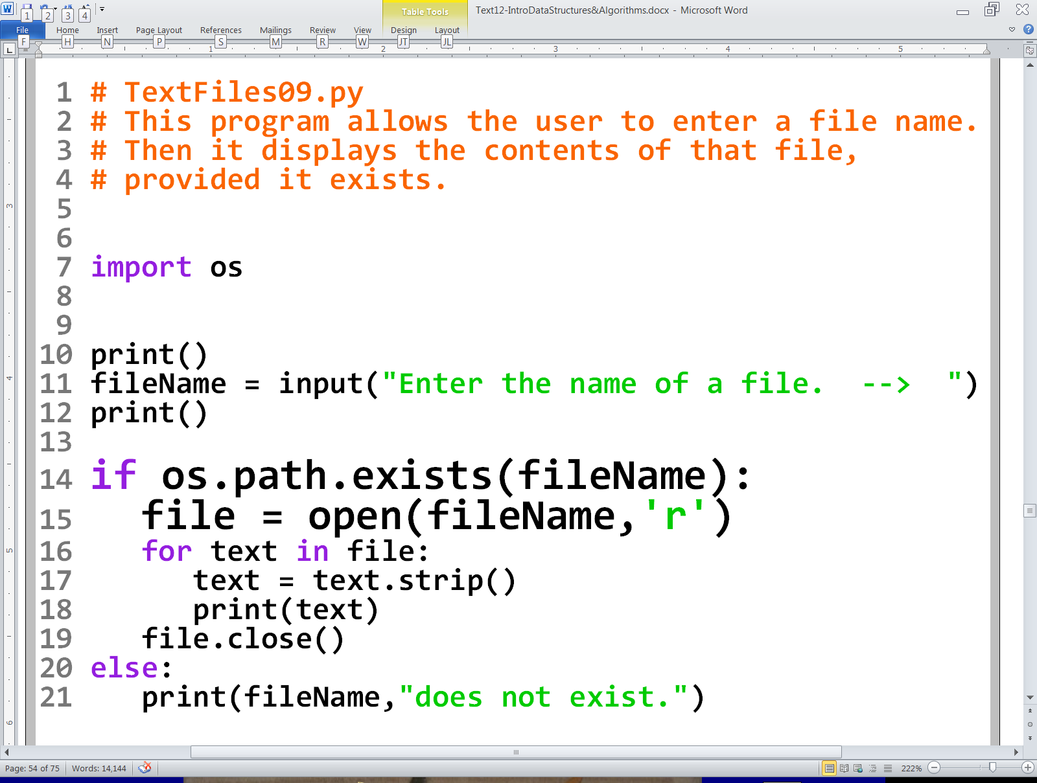
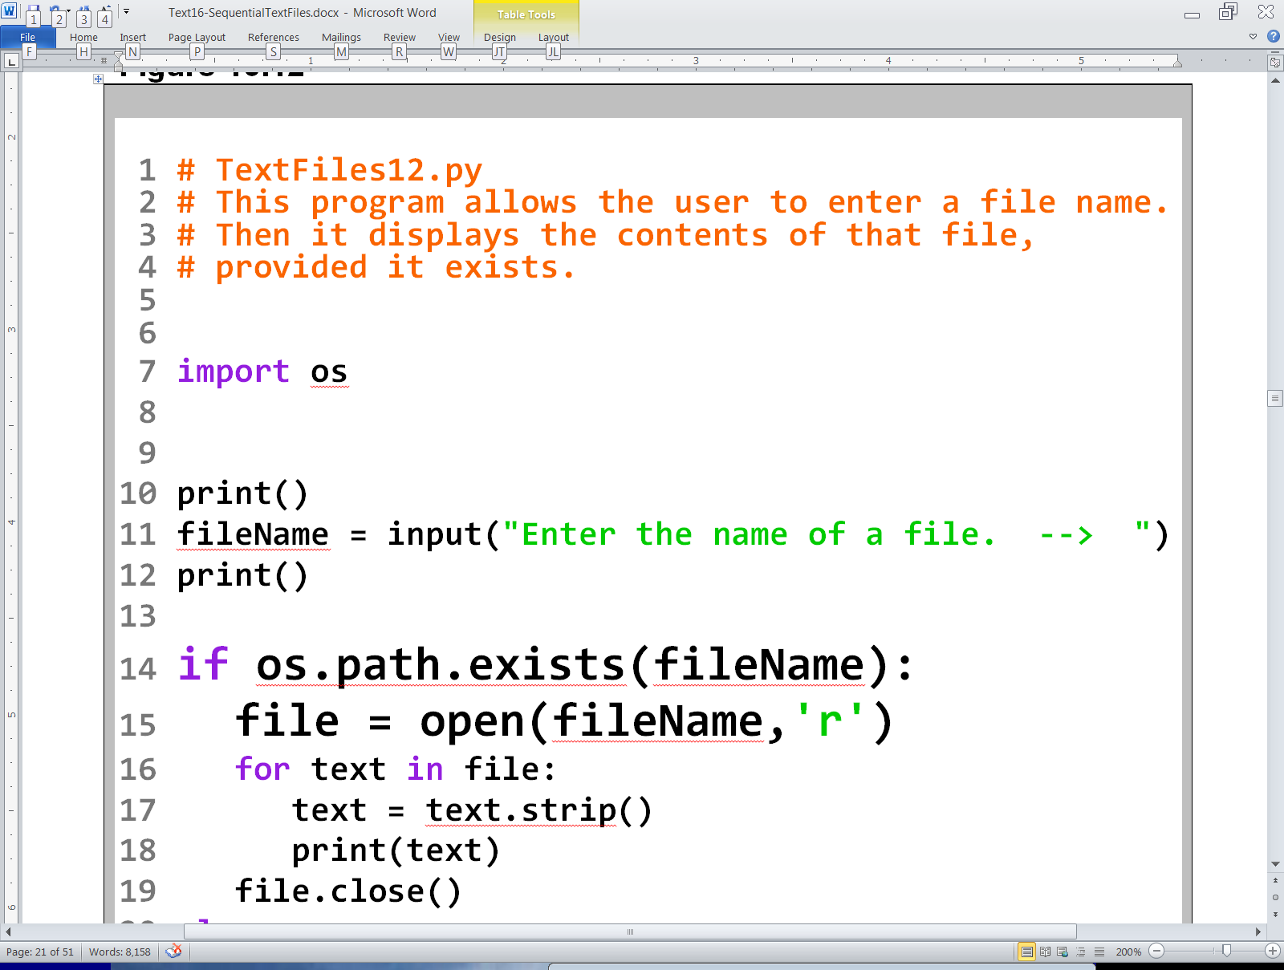

Slide 40
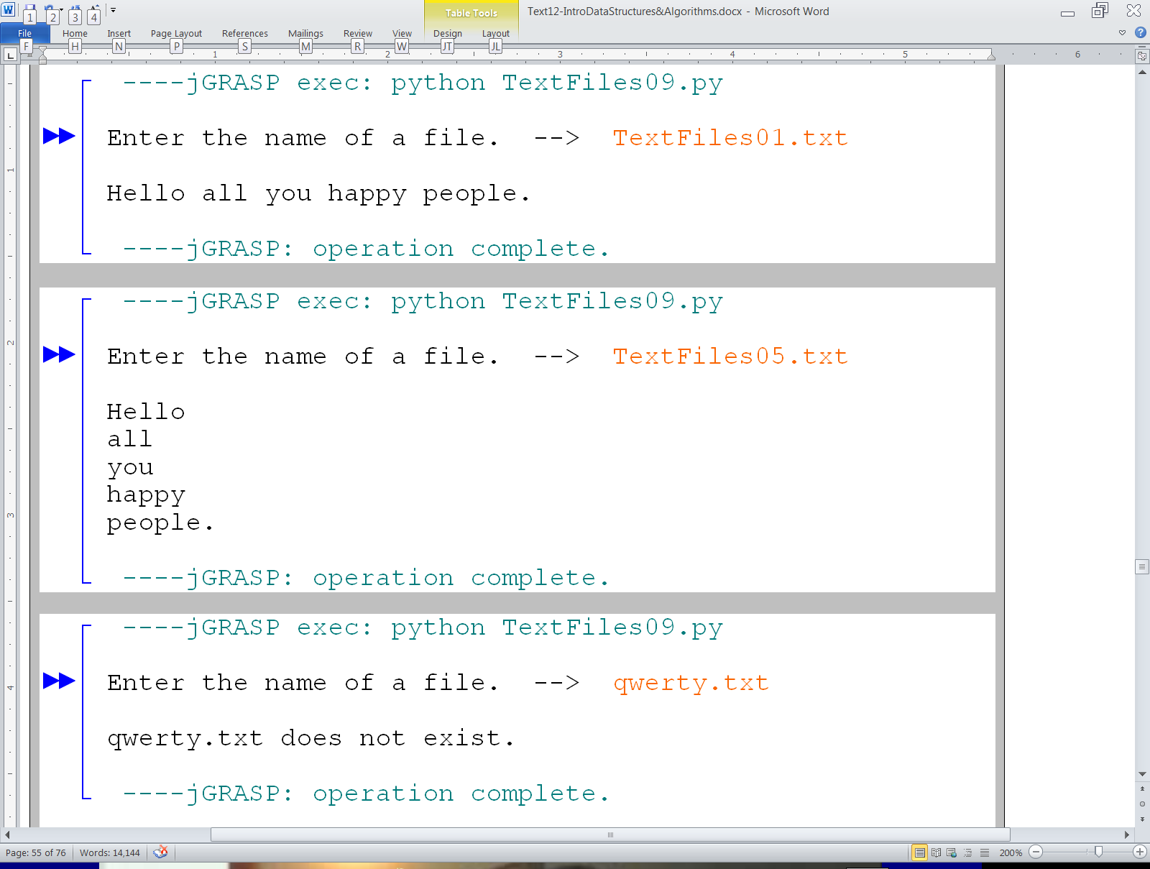
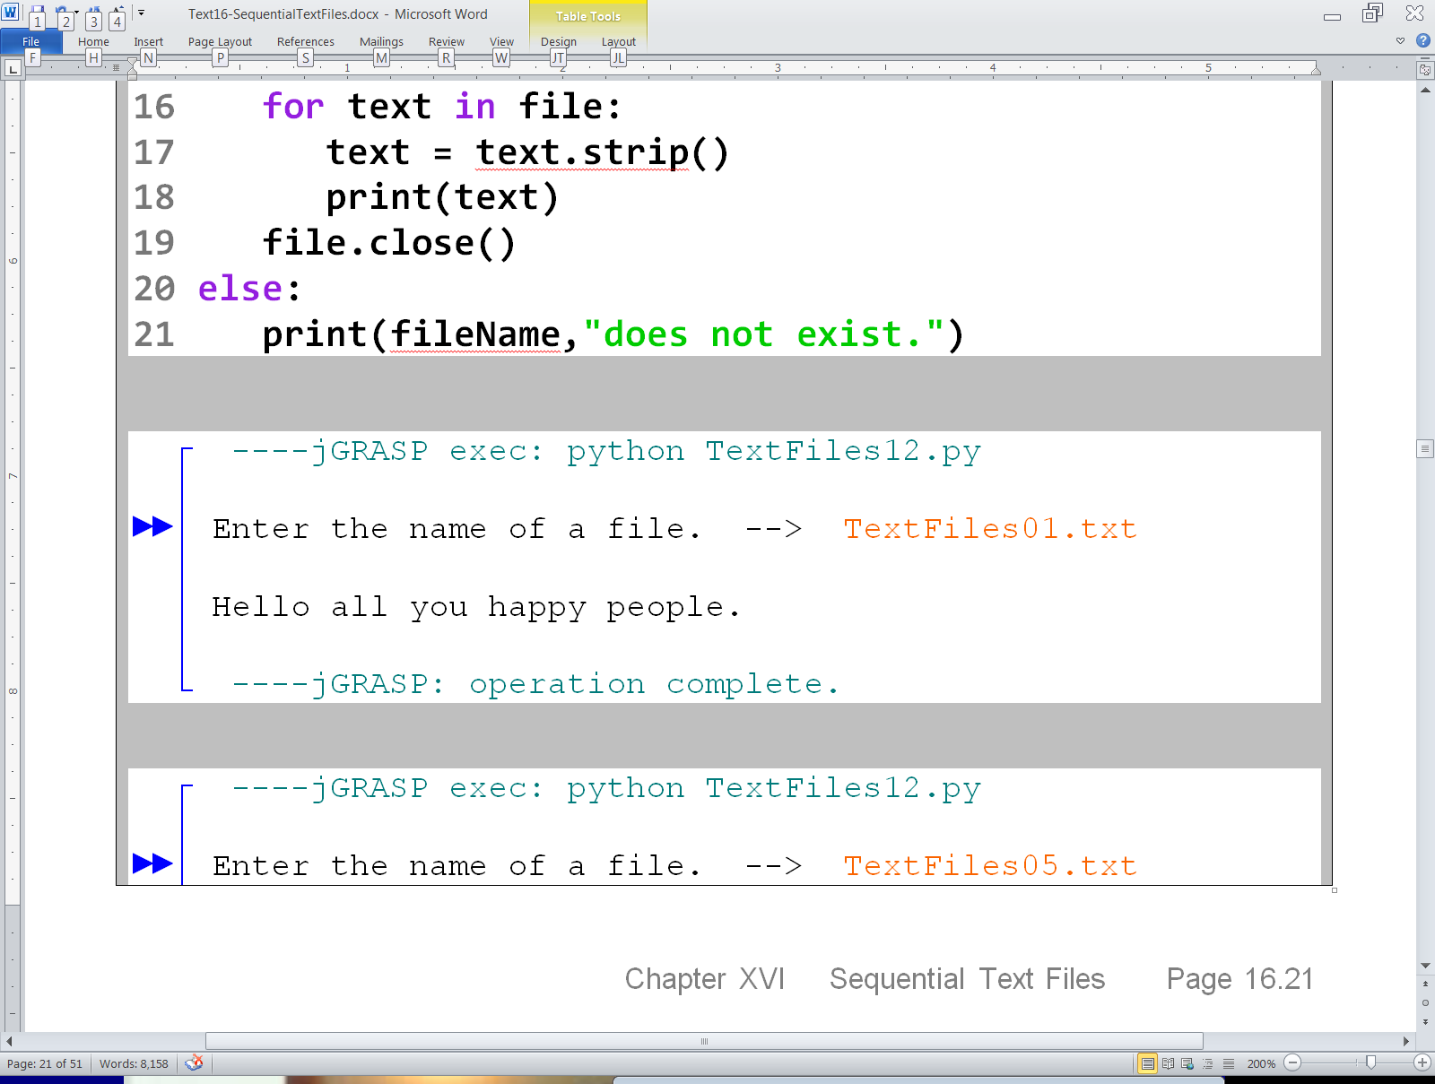
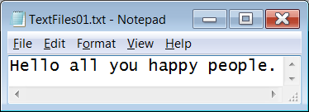
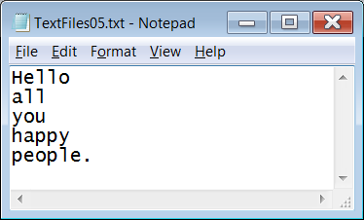

Slide 41
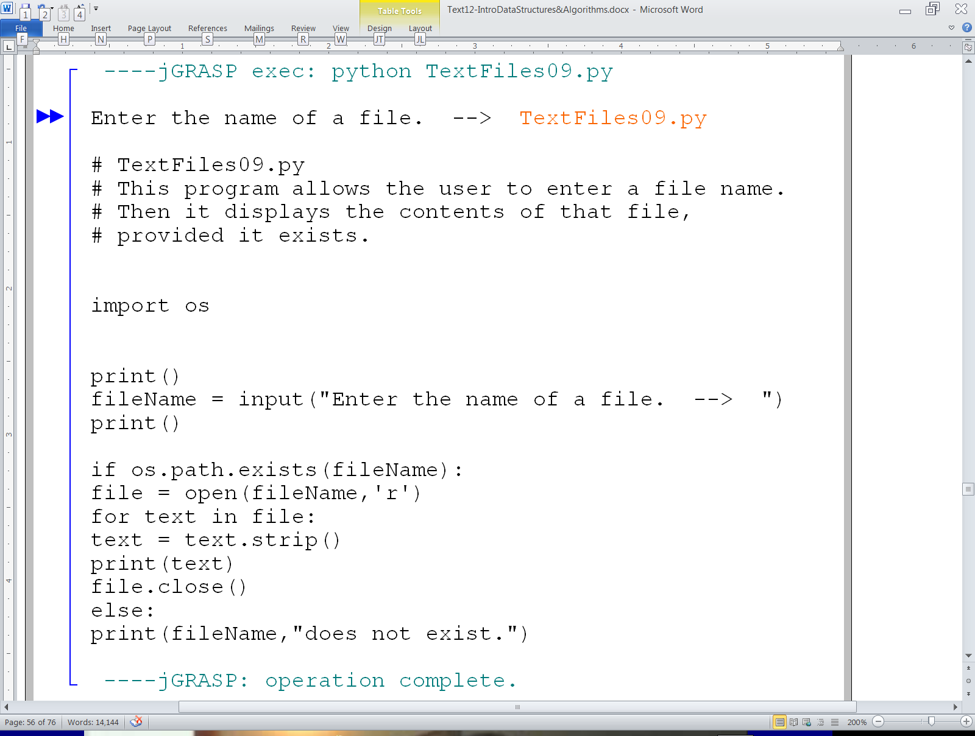
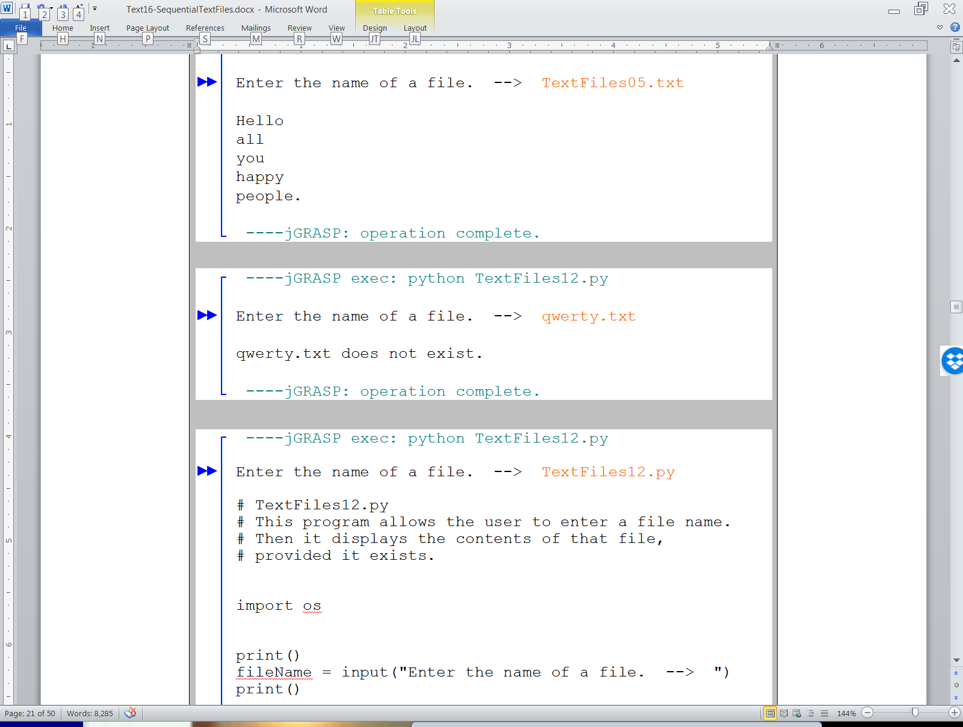

Slide 42
Yes, this program is actually displaying itself, but what happened to the indenting?

Slide 43
Yes, this program is actually displaying itself, but what happened to the indenting?

Slide 44
Section 17.4
Files of Numbers

Slide 45
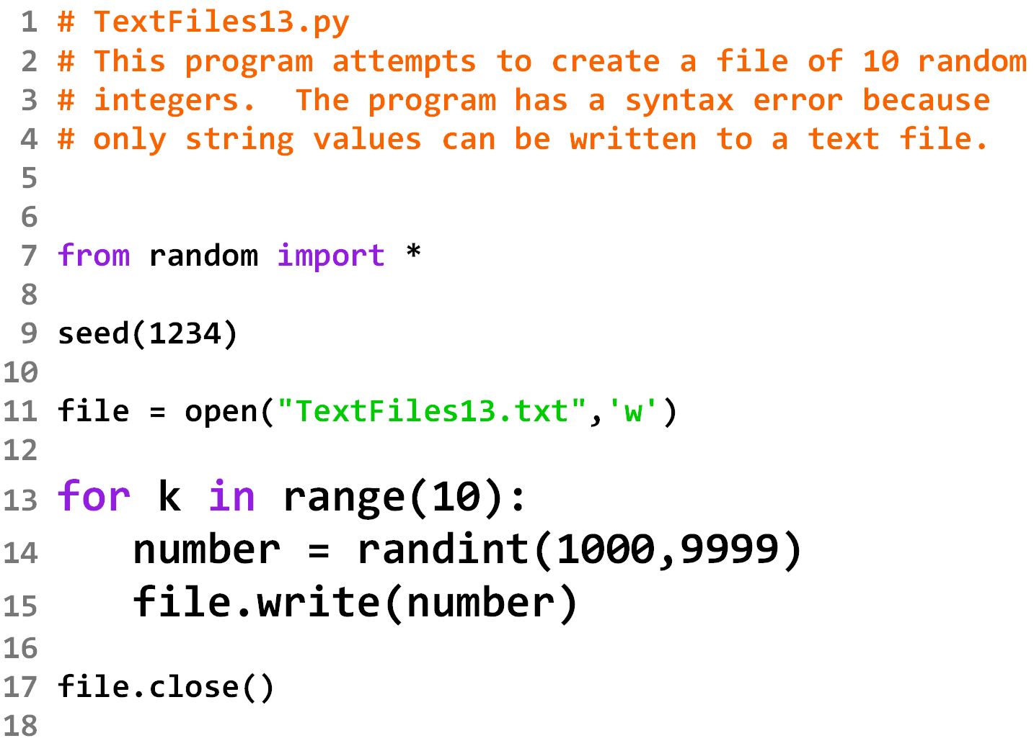

Slide 46
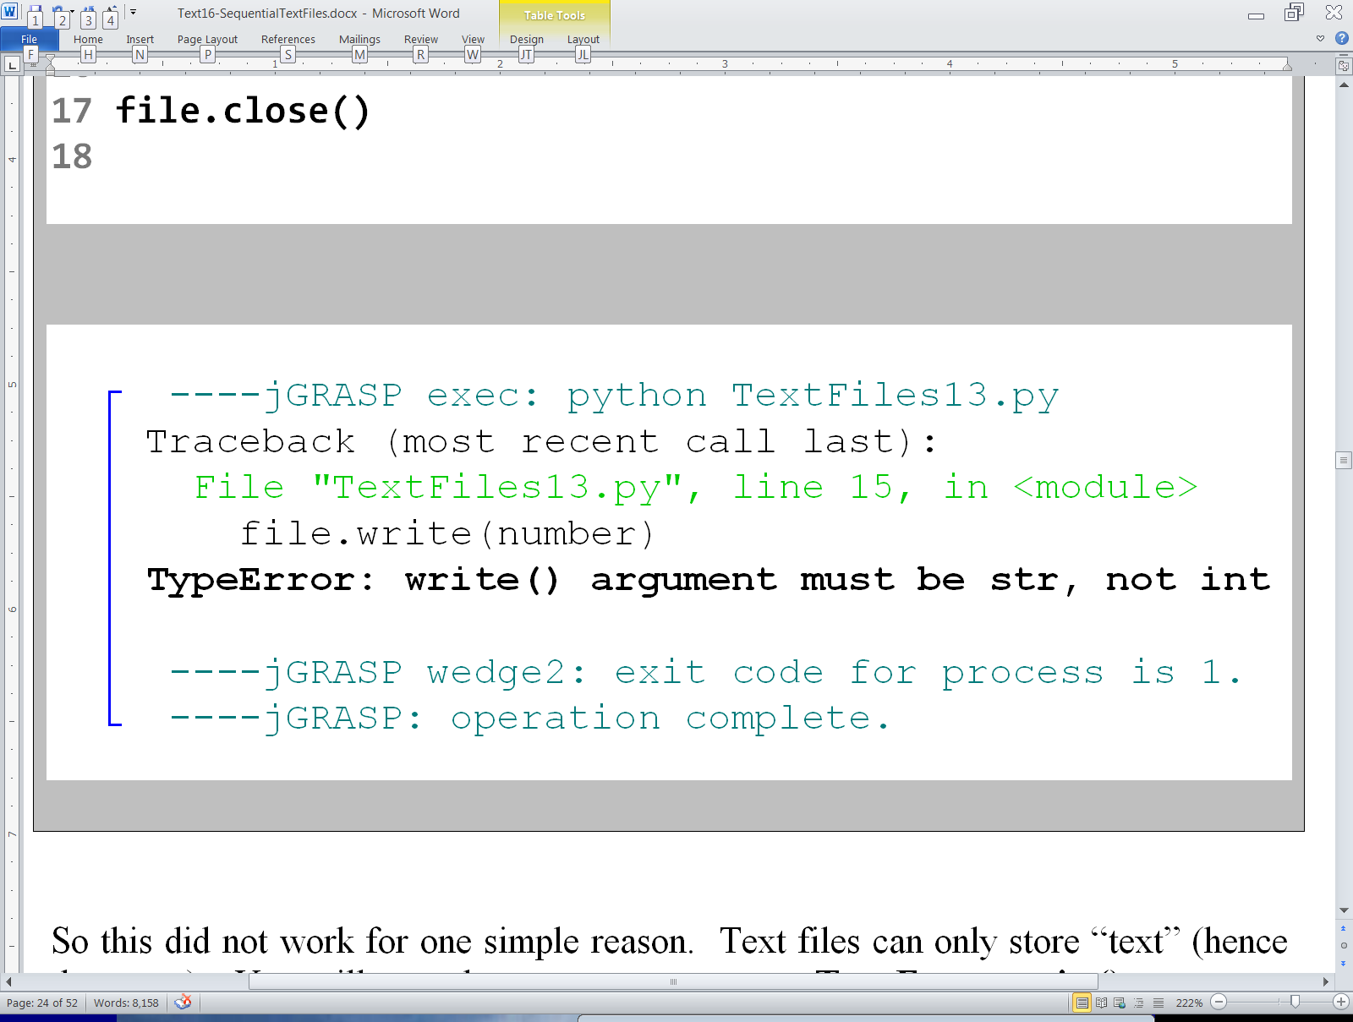

Slide 47
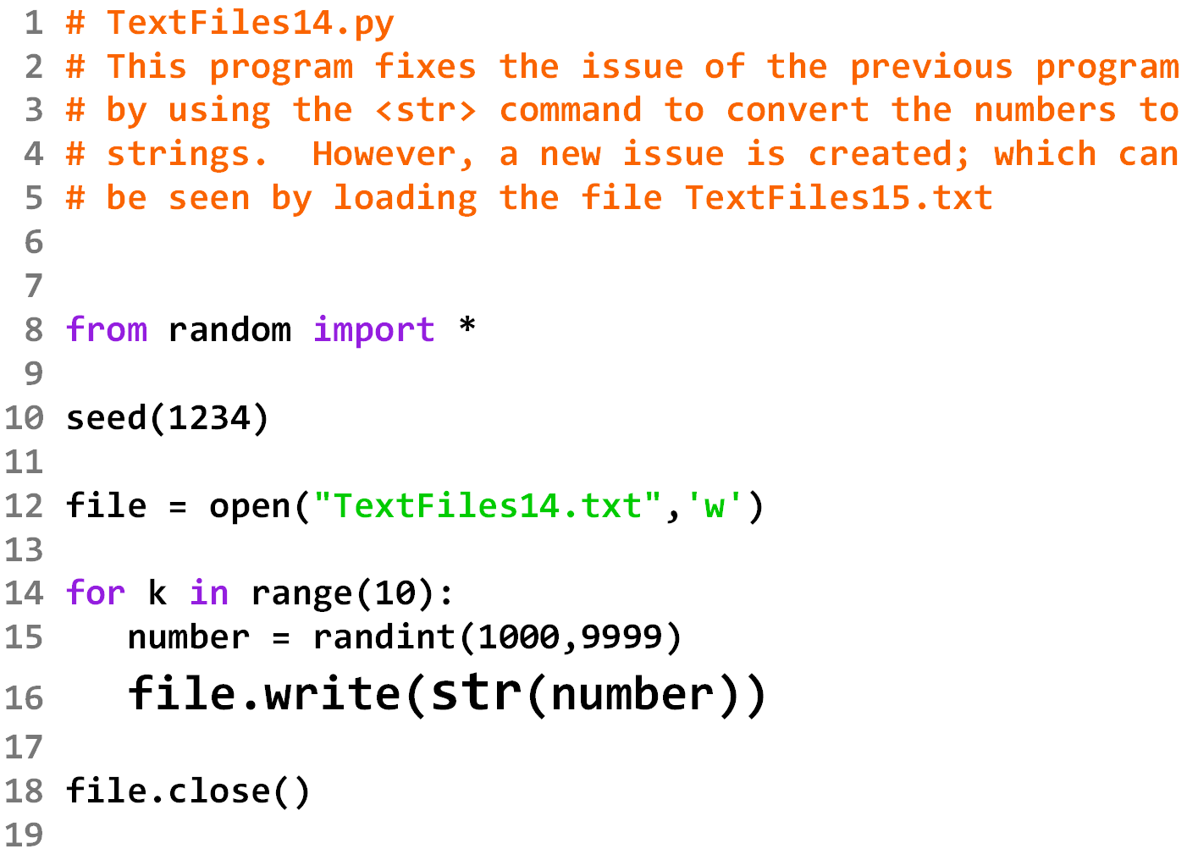

Slide 48
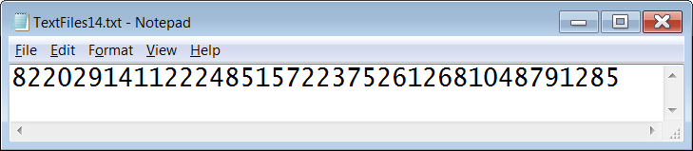

Slide 49
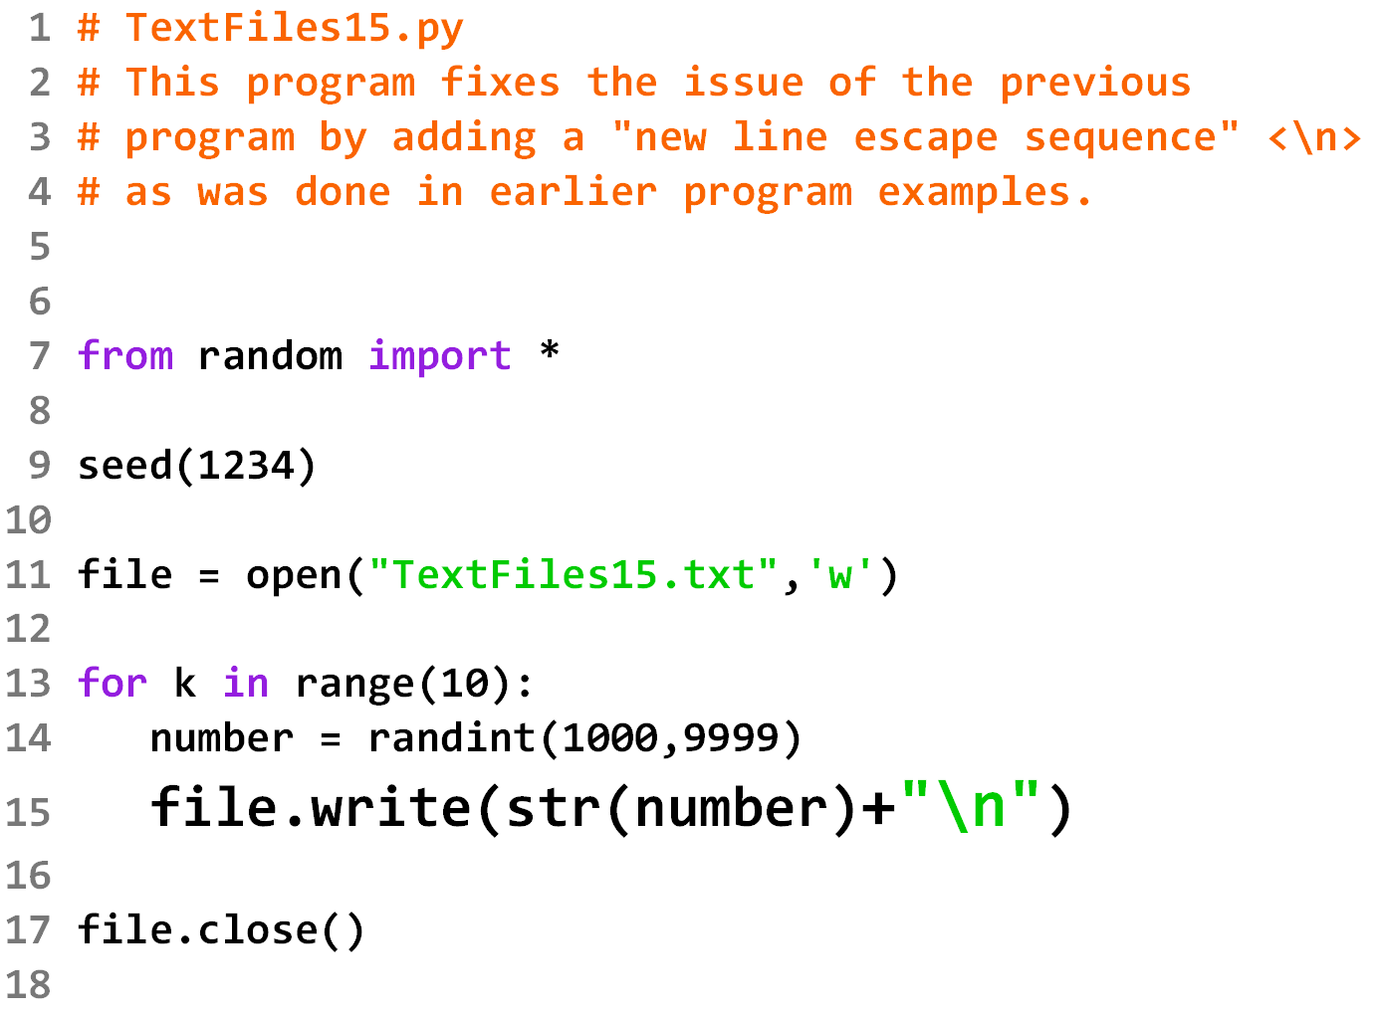

Slide 50
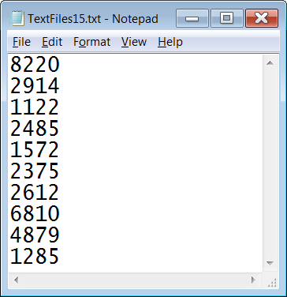

Slide 51
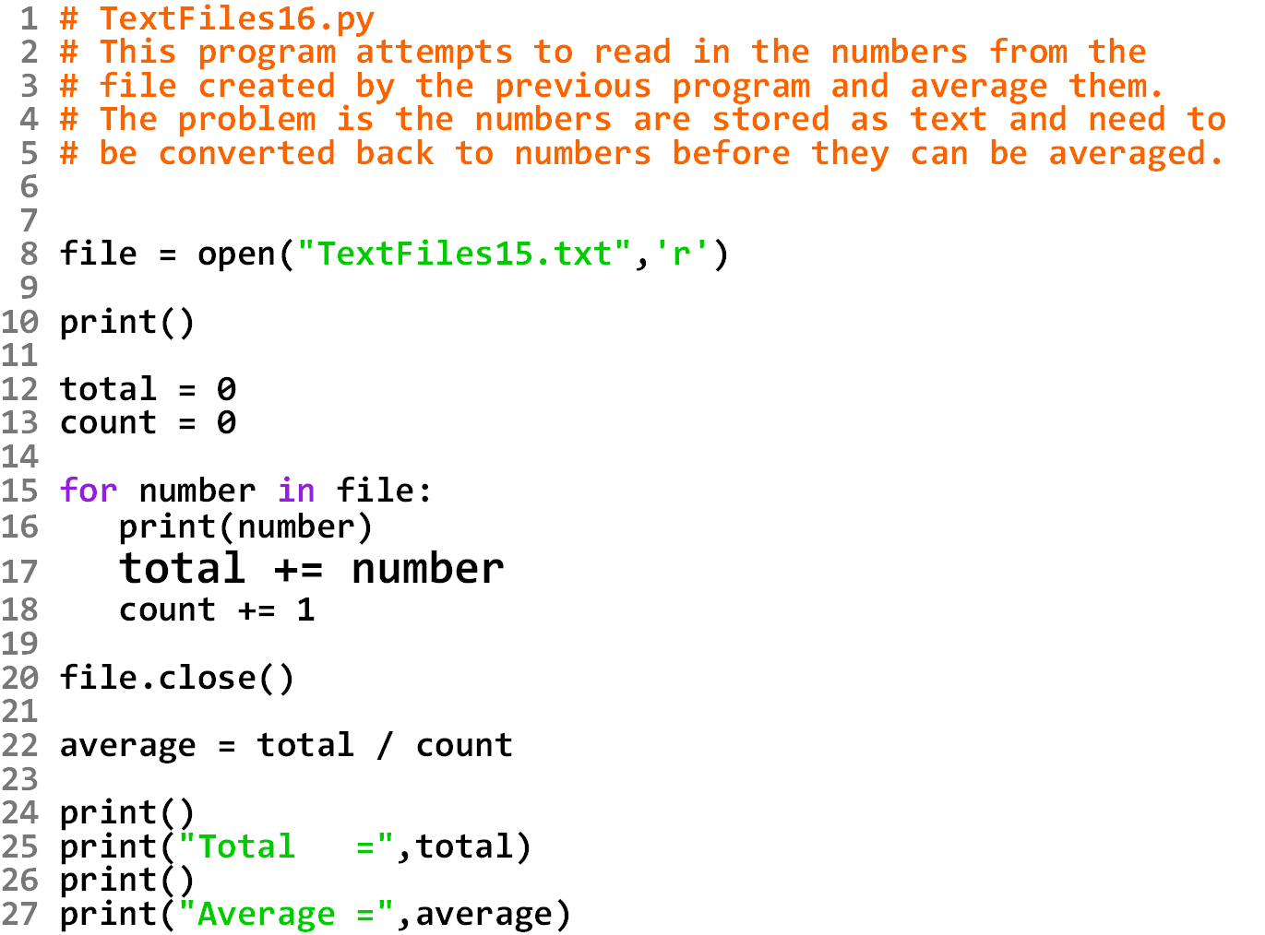

Slide 52
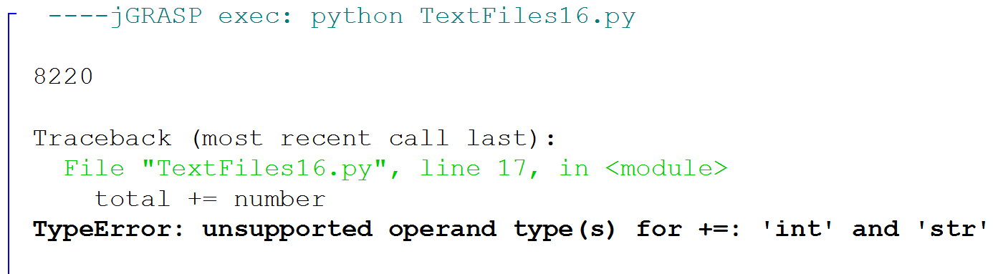

Slide 53
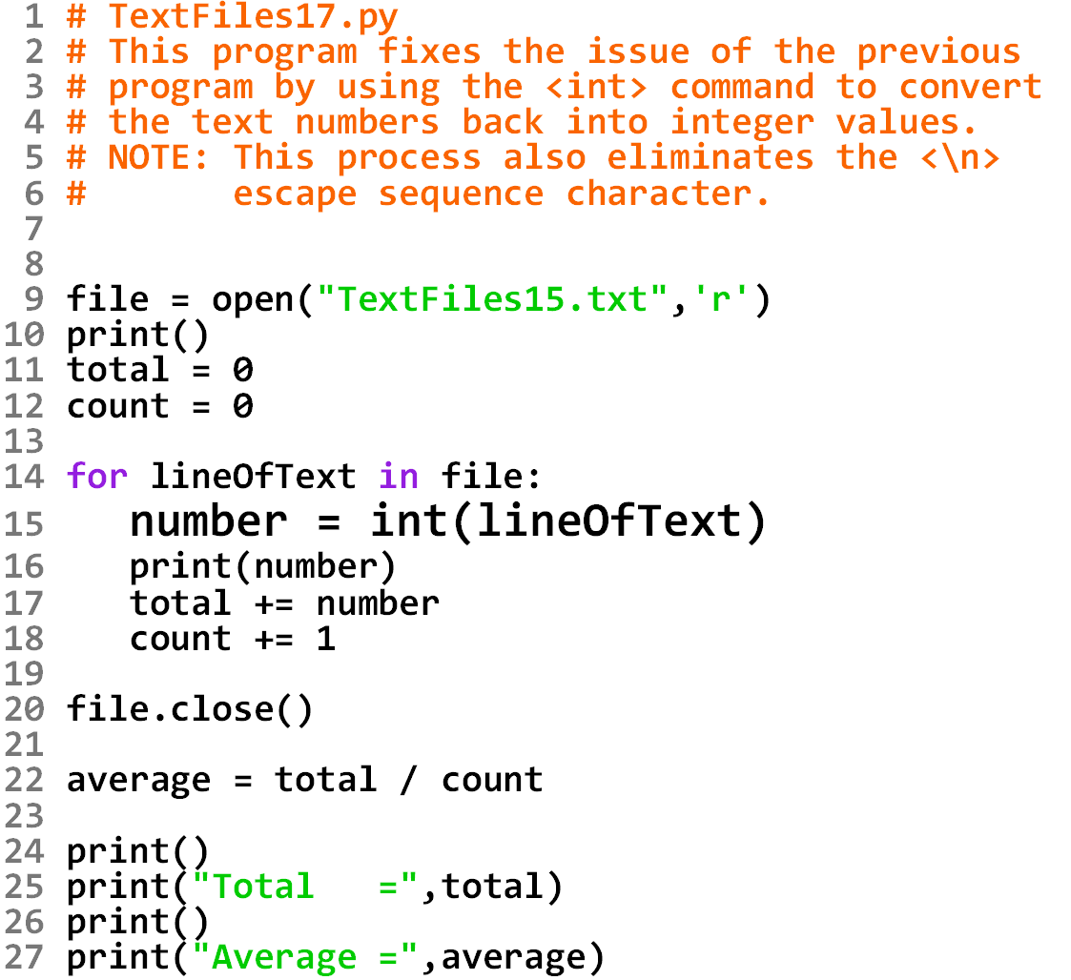

Slide 54
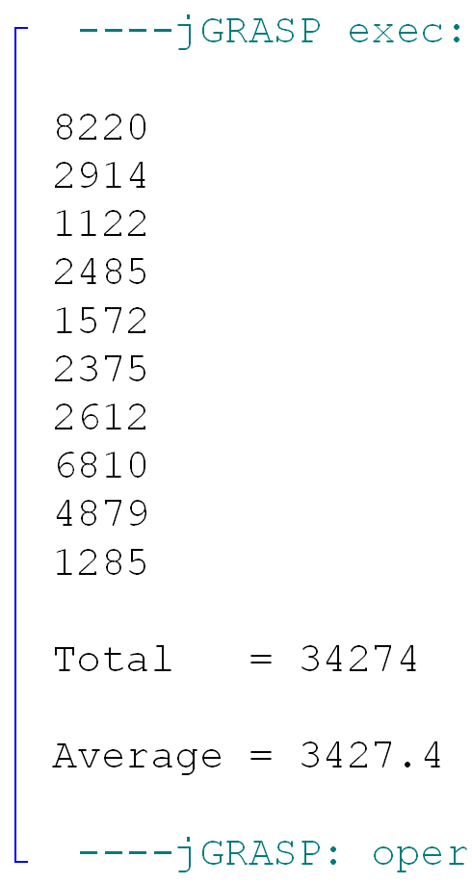

Slide 55
Section 17.5
Files of Multiple
Data Types

Slide 56
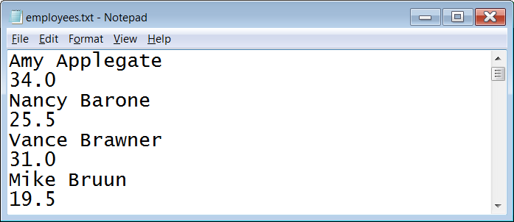
What Files Can Store
Files are not limited to merely storing either strings OR numbers. They can store BOTH strings AND numbers at the same time in the same file. This means that files can store records of information.
Remember:
A record consists of a set of fields for a specific purpose. These fields can be of the same or different data types.

Slide 57
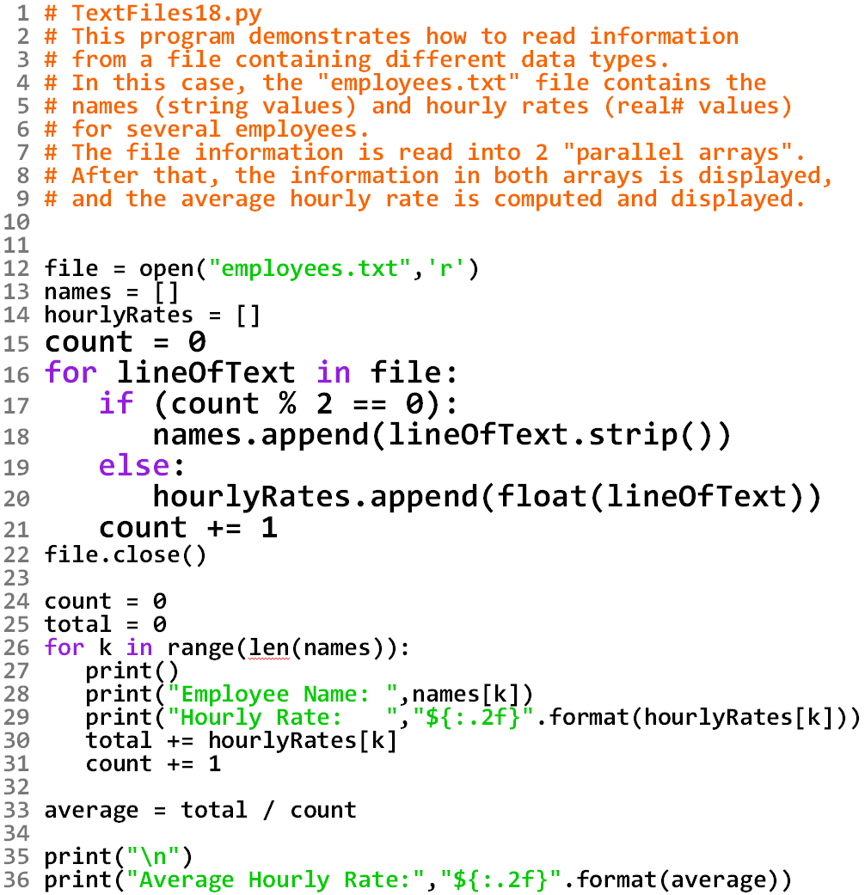

Slide 58
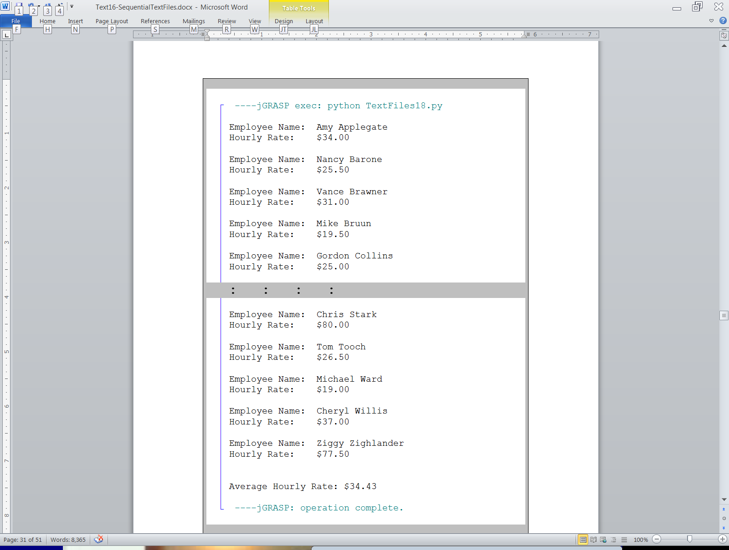

Slide 59
Parallel Arrays Example
names
0 | Amy Applegate
1 | Nancy Barone
2 | Vance Brawner
3 | Mike Bruun
4 | Gordon Collions
: | :
35 | Ziggy Zighlander
hourlyRates
0 | 34.0
1 | 25.5
2 | 31.0
3 | 19.5
4 | 25.0
: | :
35 | 77.5

Slide 60

Parallel Arrays Disclaimer
When working with multiple records of information, the use of Parallel Arrays is not the only option, nor is it the best option.
It is much more organized, efficient, and even intuitive to use an array of records to store all of the information.
However, this requires a complexity in coding that we wish to avoid in a first year computer science class.
Arrays of Records will be discussed along with Object Oriented Programming in AP® Computer Science-A.

Slide 61
Section 17.6
Reading & Writing
Simultaneously

Slide 62
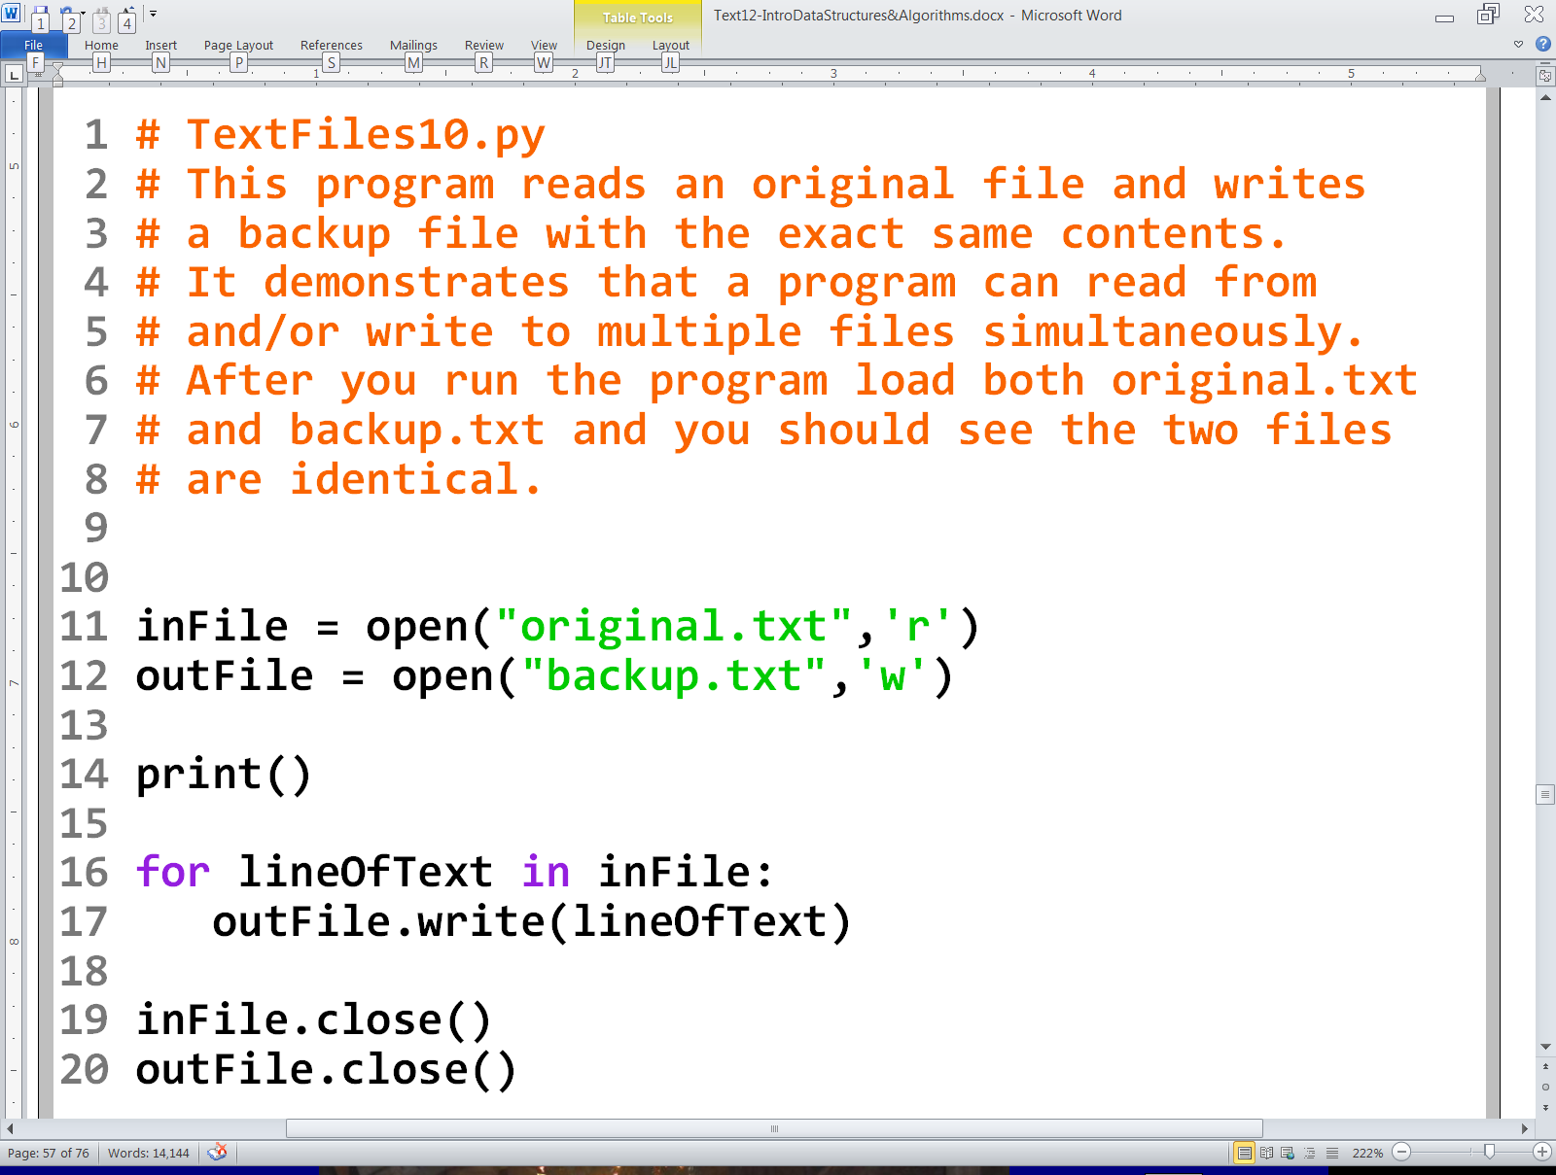
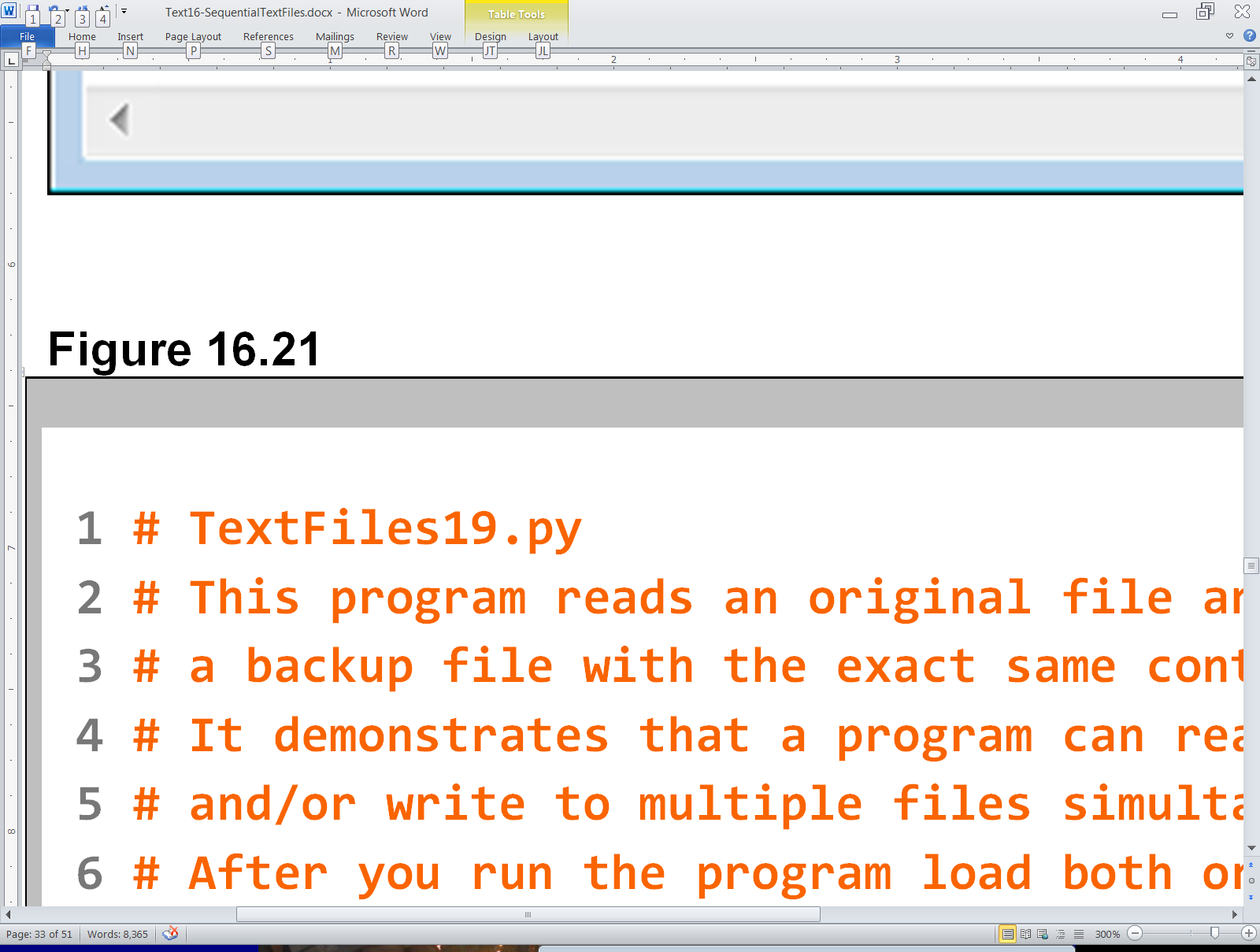

Slide 63
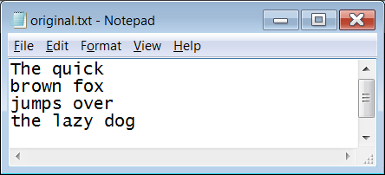

Slide 64


Slide 65
Section 17.7
Appending to
an Existing File

Slide 66



Slide 67

Output after 1st Execution

Slide 68

Output after 1st Execution
Output after 2nd Execution

Slide 69
Section 17.8
Using Text File Data
in Graphics Programs

Slide 70




Slide 71


Slide 72



Slide 73



Slide 74


Slide 75


Slide 76
Note how the graphics output precisely correlates to the characters in the text file. Try altering the characters in this file and run the program again to see what happens.

Slide 77






TextFiles23.py Data Files

Slide 78




Slide 79




Slide 80



Slide 81



Slide 82



Slide 83



Slide 84



